Slide 1
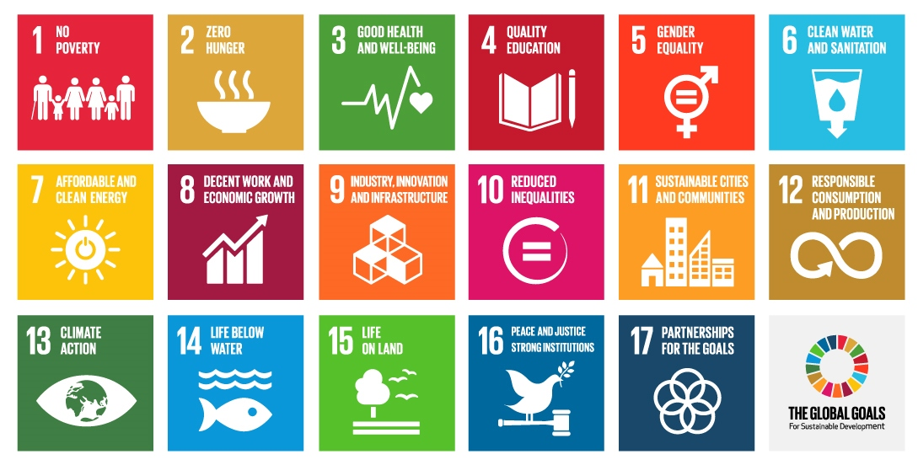
Notes:
These are our Global Goals or properly known as the Global Goals for Sustainable Development or maybe also known as the Sustainable Development Goals or SDGs.
This is our framework for the next 15 years to 2030 and for the whole world to work together to:
End to extreme poverty
Reduce inequality
Protect the planet

Slide 2
Online link to video: https://vimeo.com/138852758
Notes:
World’s Largest Lesson animation with introduction from Malala 6min 20sec - full version Vimeo - https://vimeo.com/138852758

Slide 3
Online link to video: https://vimeo.com/140567572
Notes:
World’s Largest Lesson animation 3min version - https://youtu.be/cBxN9E5f7pc https://vimeo.com/140567572

Slide 4
Notes:
So now we know more about the Global Goals what can do to help achieve them…?

Slide 5
Online link to video: https://youtu.be/QwzAivjX7VM
Notes:
Video of the Global Goals highlights from their launch since the end of September - https://youtu.be/QwzAivjX7VM 3mins 10 seconds

Slide 6
Online link to video: https://youtu.be/NH31lPYT1J4
Notes:
Global Goals Rap - Kalae Nouveau ft. Chesney Snow 1min 10 sec https://youtu.be/NH31lPYT1J4
A great way to learn the 17 Global Goals

Slide 7
Notes:
This presentation will share with you the ideas of what is a global citizen? How can we be an effective global citizen. And a few ideas and organisations that look at being advocates and active and effective positive change-makers!
With these things in mind we need to recognise and support the Global Goals framework so anything we are learning or doing in regards to global topics and issues feeds back into these goals. The Global Goals themselves also provide us with a great understanding of the things that matter and work to end extreme poverty, reduce inequality and ensure environmental sustainability. The more we know about the Global Goals the more effective we will be in achieving them.
These are our Global Goals and it is up to us to see them succeed so anyone anywhere can access to these essential components of life

Slide 8

Teaspoons of Change
Personal choices, decisions and actions that have a positive impact on people and the planet
一人一人の小さなへんかが人とちきゅうをかえていく
Notes:
In addition I have my own concept and project called Teaspoons of Change. This is where we not only look at ways to help others but also look at our own lives and how we can make a difference just in our own personal choices, decisions and actions that have a positive impact on people and the planet creating teaspoons of change!
The Teaspoons of Change approach combined with all of the great work we can do around the Global Goals gives us twice the amount of impact in the world by not only supporting others but being a responsible and active global citizen with our own choice, decisions and actions

Slide 9

South Sudan Handshake
INSPIRE • EMPOWER • ENGAGE
Notes:
Please find a partner and you will preform an South Sudan handshake.
If you are not sure what an South Sudan handshake is then take a practice and try... (then teach the South Sudan greeting of tapping the left shoulder of your partner with your right hand while they tap your left shoulder with their right hand at the same time and both of you saying the South Sudan greeting of ‘Tamam’)

Slide 10
Discuss with your handshake partner what you think is a global citizen…
Notes:
Tell your South Sudan handshake partner what you think is a global citizen…
Give specific examples of actions that you think it means to be a global citizen
(the idea of this discussion is to start to discover if you have your own idea, feelings and meaning of what global citizen means to you - all good if you don’t as that is the next question!)

Slide 11
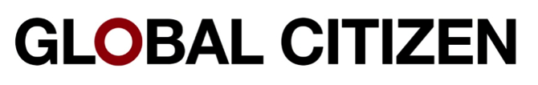
What is a
…?
Notes:
So the big question is: What is a Global Citizen? (Get answers from the audience and leave it very open)
3 more questions: 1. Do you think anyone can be a Global Citizen? 2. Do you think everyone can be a Global Citizen? 3. Do you think you are a Global Citizen?
Today you will have a chance to discover more clearly what you think a Global Citizen is and hopefully start to create a sharp picture and feelings of not only what a Global Citizen is but how you can be an active and effective Global Citizen!

Slide 12


What do the Global Goals mean…
        to you,
    your family,
    your community and
    the world
Notes:
Or you can start to think and discuss what the Global Goals mean on different levels

Slide 13
Start thinking about any questions you might have about being an effective global citizen…
Notes:
Throughout the presentation start cooking up questions about being an effective global citizen and be sure to ask me, yourself and others

Slide 14
Learning & Expectations Spectrum
INSPIRE • EMPOWER • ENGAGE
Notes:
Let us see what we want to learn or expecations we have for today and on global citizenship

Slide 15
Learning & Expectations Spectrum
UNMET | PARTIALLY MET | MET
Notes:
On a stickynote write something you want to learn today or something you hope to get out of this presentation or in regards to global citizenship - an expectation.
On the wall or board or somewhere stick your expectation under one of these headings → unmet, partially met and met.
By the end of the presentation, lesson or week revisit your expectation and see if you can now move it across the spectrum to partially met or hopefully, met. Any unmet expectations would be good to address and investigate.

Slide 16

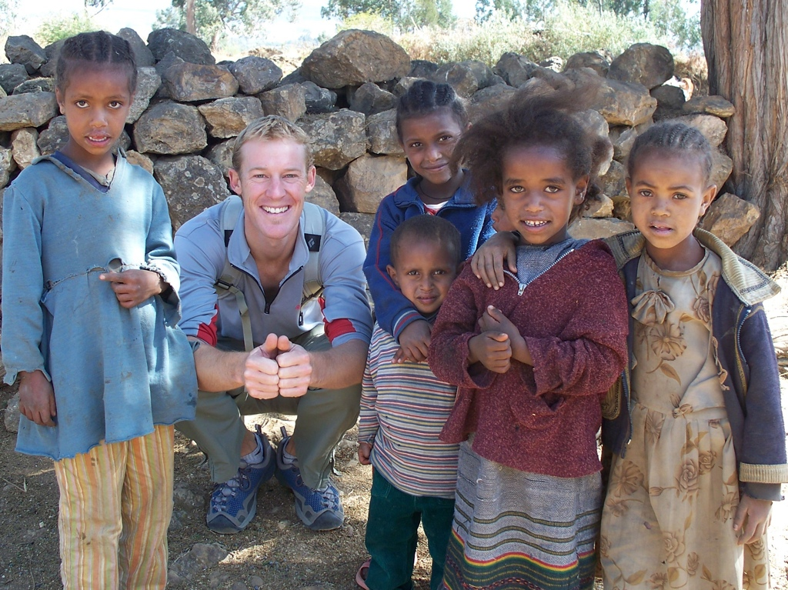

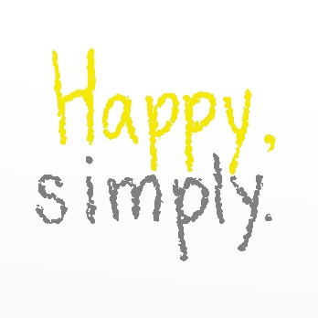
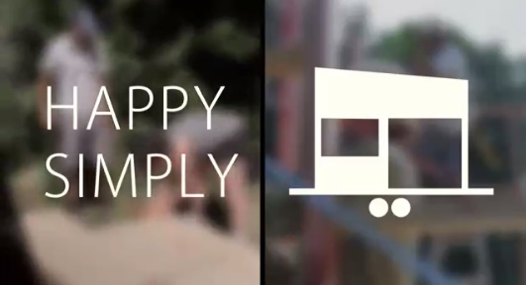

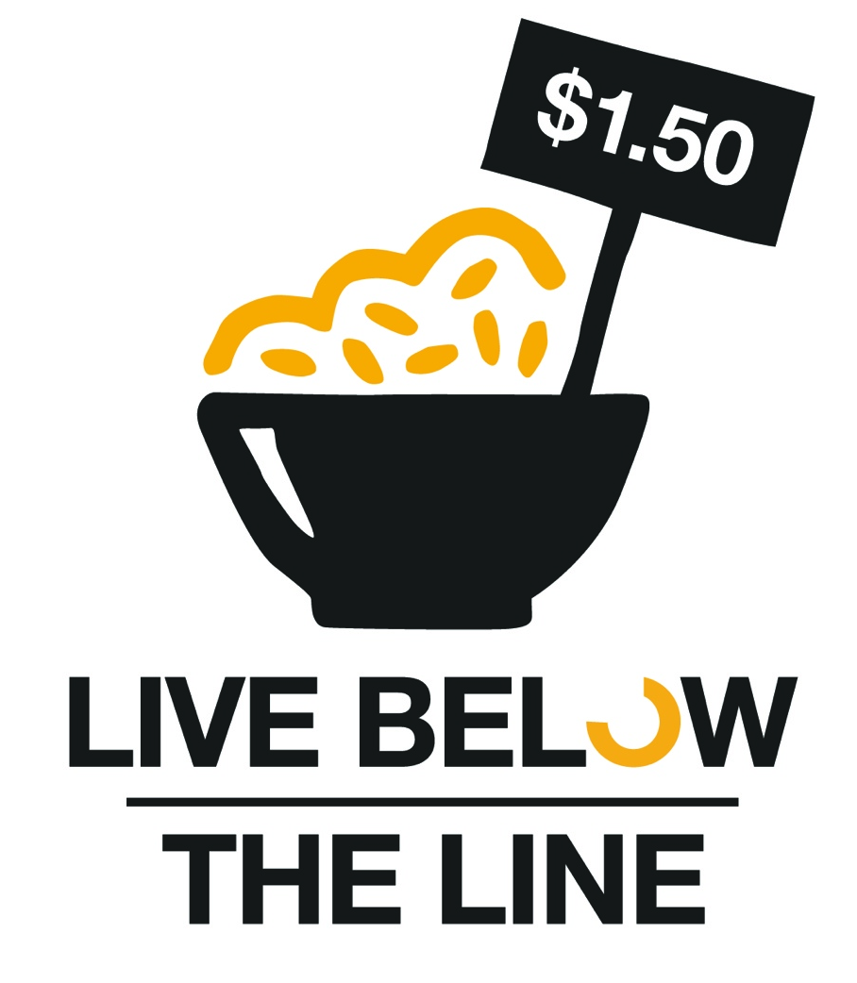




d’Arcy Lunn
Presenter, Educator, Learner & Global Citizen
JUMP! Foundation, Global Poverty Project, Polio Points, Happy, simply, UNICEF and more
Notes:
My name is d’Arcy Lunn I’m an educator, presenter, volunteer, aid worker and most importantly a learner and Global Citizen. I do a bunch of work/volunteering for a bunch of different organisations…
---
Hi, my name is d’Arcy thank you for having me today. I’m a teacher originally from Adelaide but have been very lucky to teach and travel around the world for over 10 years.
---
Hi my name is d’Arcy Lunn and, on behalf of the Global Poverty Project, I would like to thank you for having me to give this presentation of 1.4 Billion Reasons.
My purpose today – and our purpose at the Global Poverty Project – is to share with you our vision of a world without extreme poverty. In the presentation today we will explore with our heart and our head how we can see an end to extreme poverty within a generation, and how we can be a part of making this happen.
We are not here to raise money from you. Of course, donating is one of the things that will help and you can do. But that is not the purpose of this presentation.
We are here to develop a clearer understanding of the issues, and the role that each of us can and must play in supporting the world’s poorest people to work their way out of extreme poverty.
Of course these are big and complex issues – and we’re not going to solve the world’s problems by ourselves here today.
Instead we will look at what we do know, and what we can do, because extreme poverty is about people just like us – mothers, fathers, brothers and sisters with hopes and dreams, concerns and challenges just like us.

Slide 17
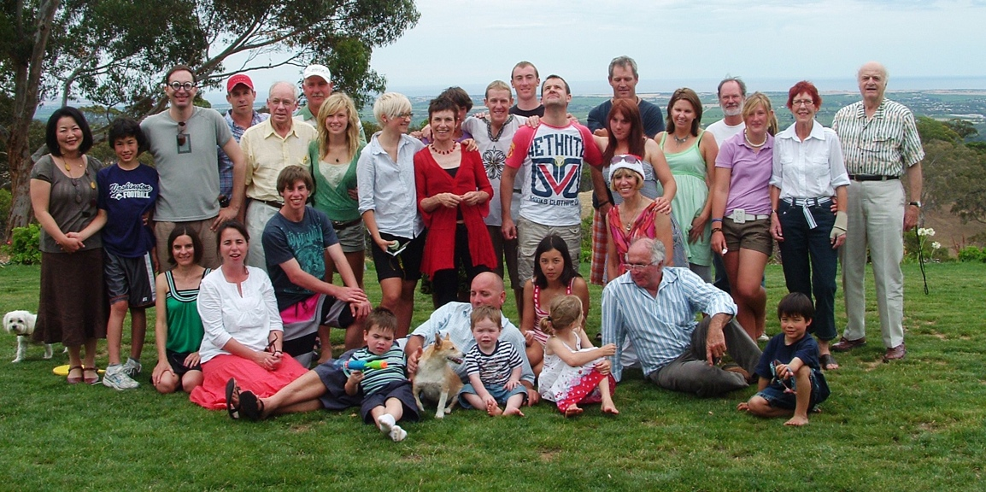
Notes:
The reason I care about global topics and issues is...
I come from a large family in Australia and am the very youngest of 6 children. I feel I was very lucky to have been brought up in a place with education, health services, clean water and infrastructure to support me to have access and opportunity to do anything in the world…

Slide 18
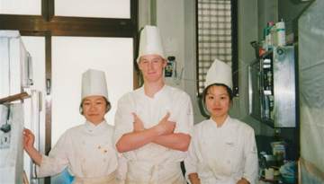
Notes:
When I was 18 I finished high school and wanted to go and do something different to school having been at school for 13 years! I ended up working in a bakery in Japan. I didn’t know how to speak Japanese nor how to bake. The big lesson I learnt from this experience was that there are no rules in life and I could decide to do anything if I wanted. In just 3 months I had learnt to speak decent Japanese and to make decent Japanese bread but really I had learnt to take on any challenges even if they sounded difficult (or strange!).

Slide 19
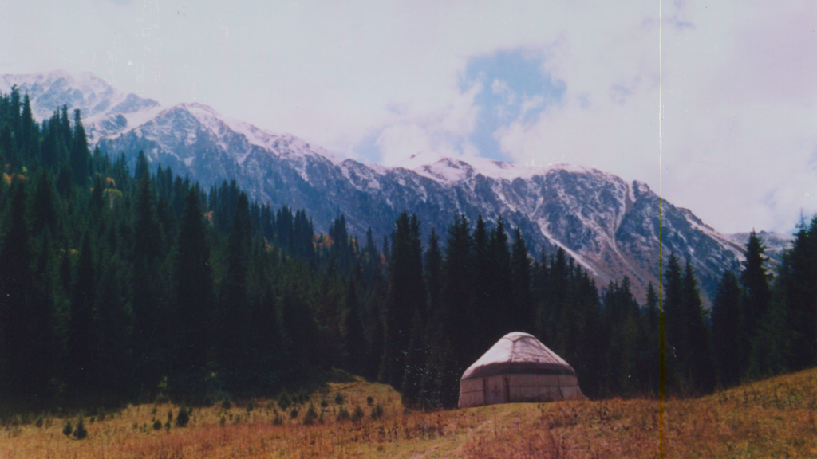
Notes:
I did go back to Australia to university and graduated as a primary school Japanese teacher - but I’ve never taught primary school Japanese. Instead after finishing university I went out to see the world and went to go and climb mountains in Kyrgyzstan, a small country with big mountains. Again I was happy to take on the challenge of going to a country neither I or most other people had heard of much before.
I had a big turning point in my life while in Kyrgyzstan.

Slide 20
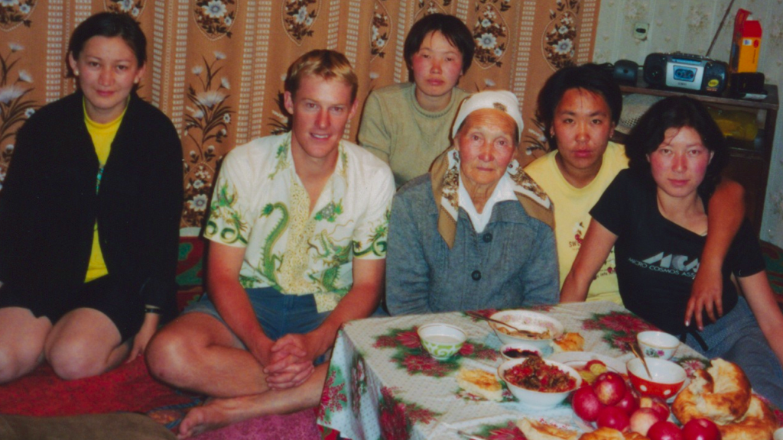
Notes:
While in Kyrgyzstan I thought I would also do some volunteering and spent time at a university in east Kyrgyzstan. He I am with Gyldyz, Norgiza, Gyldyz’s grandmother and a couple of the other teachers from the university.
As a volunteer I thought I would go and help others but really I learnt and received far more than I could ever give! I learnt a lot about life from these amazing women. The salary for these women as university teachers was $40 US dollars for one month which meant they were virtually living in extreme poverty. It also they meant they had to be very resourceful, resilient, grow their own food and share with each other and build a strong community.

Slide 21
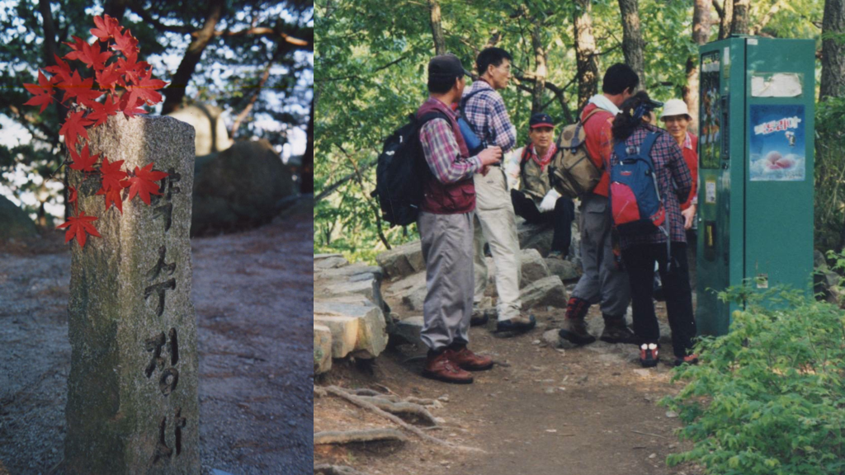
Notes:
After my time learning in Kyrgyzstan I went through Kazakhstan, Russia, Mongolia and China doing more volunteering until I ran out of money and then went to South Korea to do some paid teaching. Here I knew I was in a developed country once again when I went for a hike as I like to do and at the top of the mountain there was a ice cream vending machine.
In South Korea my wage as a teacher was $40 US dollars for one hour and I remember at the end of my first week of work as I held the money in my hand and I asked why? Why me? Why does the world work like this? I didn’t work any longer, I didn’t work any harder and I wasn’t any smarter than Gyldyz and my other friends teaching in Kyrgyzstan. The only fact I could come up with was that I was born where I was born and they were born where they were born having different access and opportunity in life.

Slide 22
Notes:
And so since then I have always continued to ask that question of why and to do my best to learn more and take action to see more equality and access and opportunity to anyone anywhere regardless of where they are born.

Slide 23
What did I want to BE in the future?
What did I want to DO in the future?
Notes:
Ask your partner and answer your partner - what do you want to be in the future?
Ans: I personally have no idea
Now ask them - what do you want to do in the future?
Ans: that is the key we often become what we think we should be rather than do what we want to do
Give specific examples of what might be different. Also think of what developed countries could learn from developing countries…

Slide 24
What is your job?
Where do you live?
How do you get paid?
Notes:
The three hardest questions I get asked are:
What is your job?
Where do you live?
How do you get paid?
I don’t have any simple answers to those questions so simply answer with the following…
I do different things…

Slide 25
Do different things…
Notes:
I do different things…

Slide 26
in different places…
Notes:
in different places…

Slide 27
at different times…
Notes:
at different times…

Slide 28
with different people…
Notes:
with different people…

Slide 29

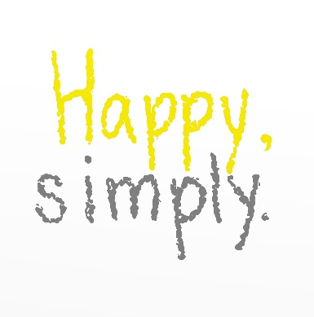





LOTS OF DIFFERENT PEOPLE!
Notes:
And I do things with LOTS OF DIFFERENT PEOPLE
I try to make sure I know all the good things that are out there in the world making a difference and for me to join in with them when and where possible

Slide 30
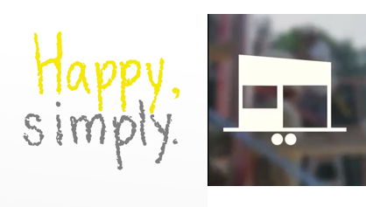
Some of my own…
Notes:
Then sometimes I feel there is a gap and so I have created my own ideas and actions like Polio Points - a schools award and reward program that helps vaccinate children from polio, Happy, simply - a sustainable lifestyle model and education project and Teaspoons of Change as I have explained earlier.

Slide 31
2 simple ways to be
active & effective
Global Citizens…
Notes:
Let’s start with two very simple but effective ideas and ways to be active and effective global citizens

Slide 32
1.
Good people
with good ideas
doing good things!
Notes:
One of the easiest and most effective ways to be a global citizen is knowing good people with good ideas doing good things!
I feel this is one of the easiest and most beneficial ways of being an active and effective global citizen

Slide 33
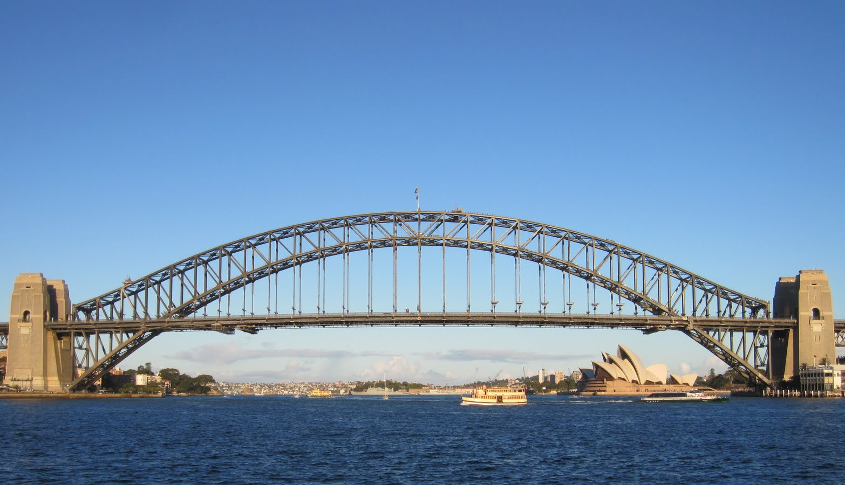
2.
Notes:
Cryptic clue Any guesses? Sydney Harbour Bridge. So what does that have to do with being an active and effective global citizen?
The answer is to be a bridge.
A really easy and effective way to create positive change in the world is to know good people who do good things and connect them with those people to want to do good things. I make sure I know a bunch of excellent role-models and organisations that people can go to so they can join in the movement to end extreme poverty, to protect and rejuvenate the environment or see clean water and sanitation for all or any major topic and solution.

Slide 34
I want to be the best global citizen I can possibly be…
Notes:
My ambition in life is to be the best humanitarian I can be. So what does that actually look like?

Slide 35
To see the end of extreme poverty for everyone, everywhere and forever!
Notes:
Working towards increasing the number and effectiveness of the movement to end extreme poverty for everyone, everywhere and forever!

Slide 36
and ensure environmental sustainability of the planet for the future!
Notes:
And ensure environmental sustainability of the planet for the future

Slide 37
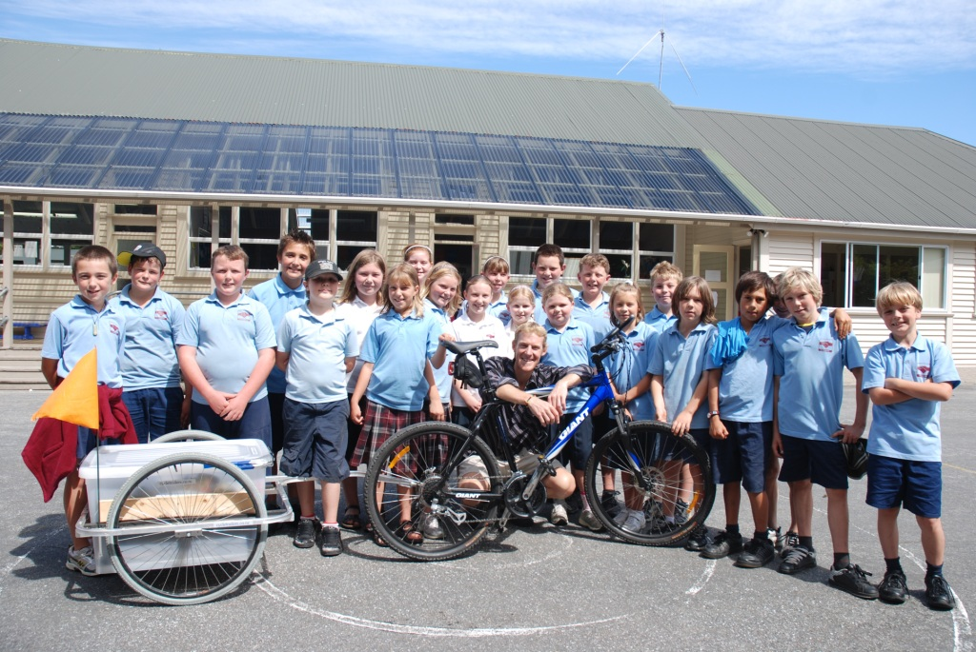
Notes:
The other thing about being an effective global citizen is to do what you are interested in or where you are gifted and combine that with you passion for a global topic or cause. In the case of this photo I rode a bike around the South Island of New Zealand, which I love doing, and combined this with my passion for giving presentations and sharing stories on ending extreme poverty

Slide 38
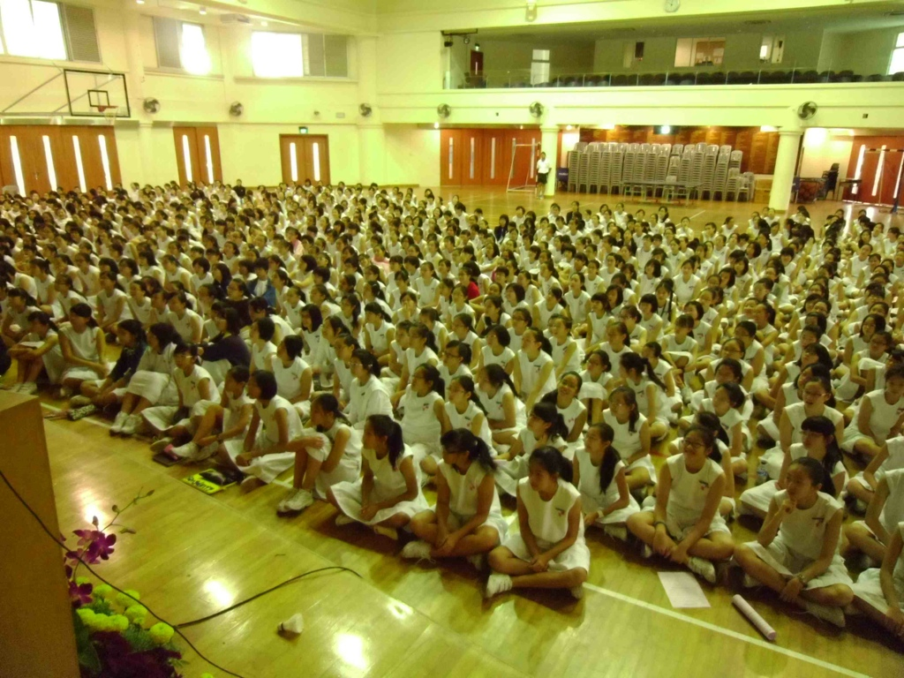
Notes:
I have also put my teaching experience and able to give large presentations, like this one to over 700 year 9 girls at a school in Singapore.

Slide 39
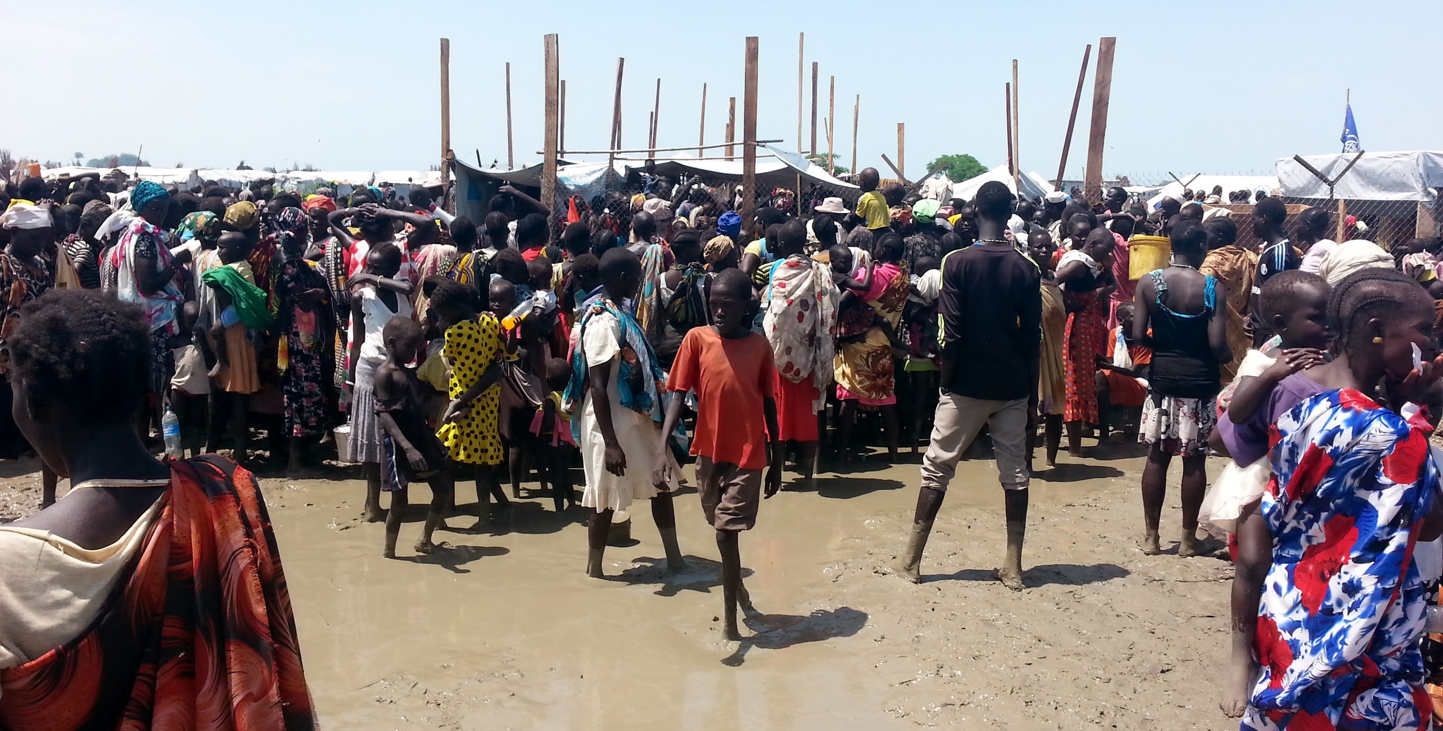
Notes:
These days I try and balance a life of both kinds of experiences of working on-the-ground to learn more and then share what I have learnt through advocacy, presentations and public/political engagement.
This is a photo from the Bentiu Protection of Civilians (PoC) in South Sudan where I learnt a lot about life and will share with you some of the lessons I learnt later in the presentation

Slide 40
One Minute Junior Videos from UNICEF
https://www.youtube.com/user/UNICEFoneminutesjr
Notes:
This is a wonderful video made by teenagers in a remote part of eastern South Sudan who filmed their own stories - here is the story of Nirindit from Pibor or of Jamal returning from the war
Link to other 1 Minute Juniors videos from around the world: https://www.youtube.com/user/UNICEFoneminutesjr

Slide 41
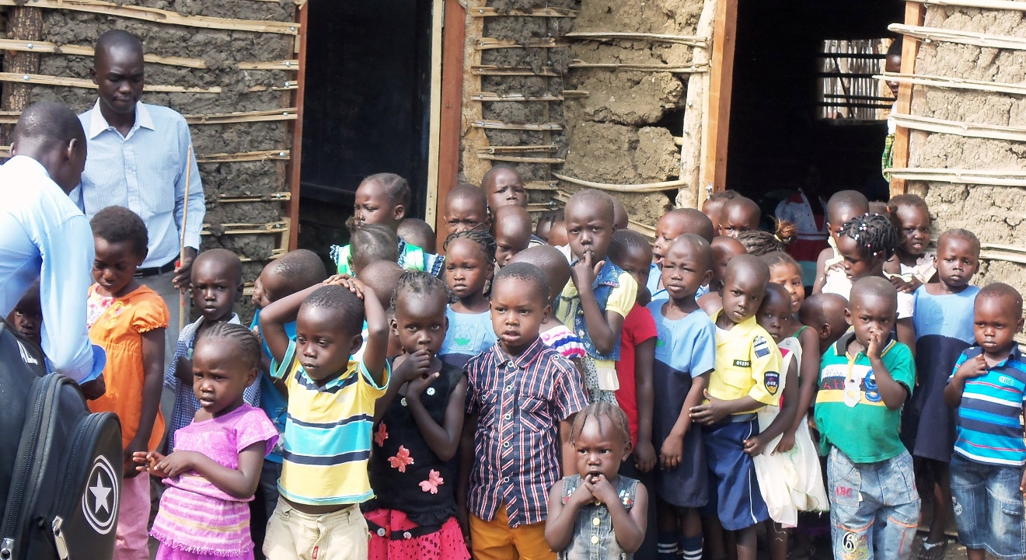
Notes:
Another picture here of a polio campaign to immunise children and keep them safe from polio and other preventable diseases

Slide 42
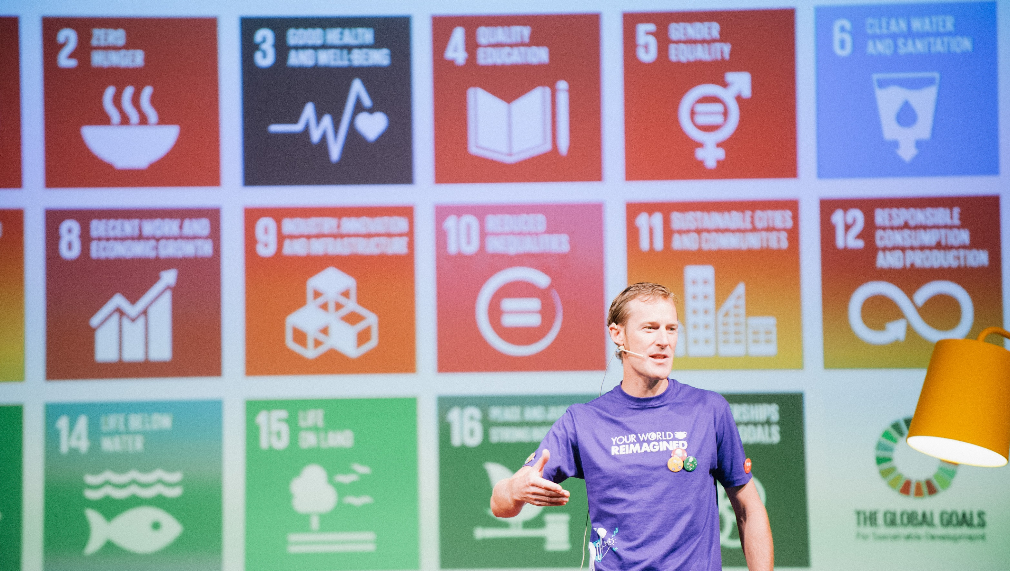
Notes:
So I am a Global Citizen not because I have been to over 80 countries in the past 15 years or because I am standing here in front of a sign with the Global Goals but I think and act as a global citizen knowing my choices, decisions and actions have an impact on people and the planet…

Slide 43
Is knowing my choices, decisions and actions have an impact on
people and the planet…
Notes:
So for me, being a Global Citizen is: knowing my choices, decisions and actions have an impact on people and the planet.

Slide 44
Is knowing I’m connected to
people and the planet…
Notes:
A decent statement on being a Global Citizen is: knowing I’m connected to people and the planet.
This is only one meaning of a global citizen and what is more important is that we all have our own meaning and we specifically know what being a global citizen means to us - in the way we think as a global citizen, what we feel as a global citizen, the things we say as a global citizen and most importantly what we do as a Global Citizen!

Slide 45
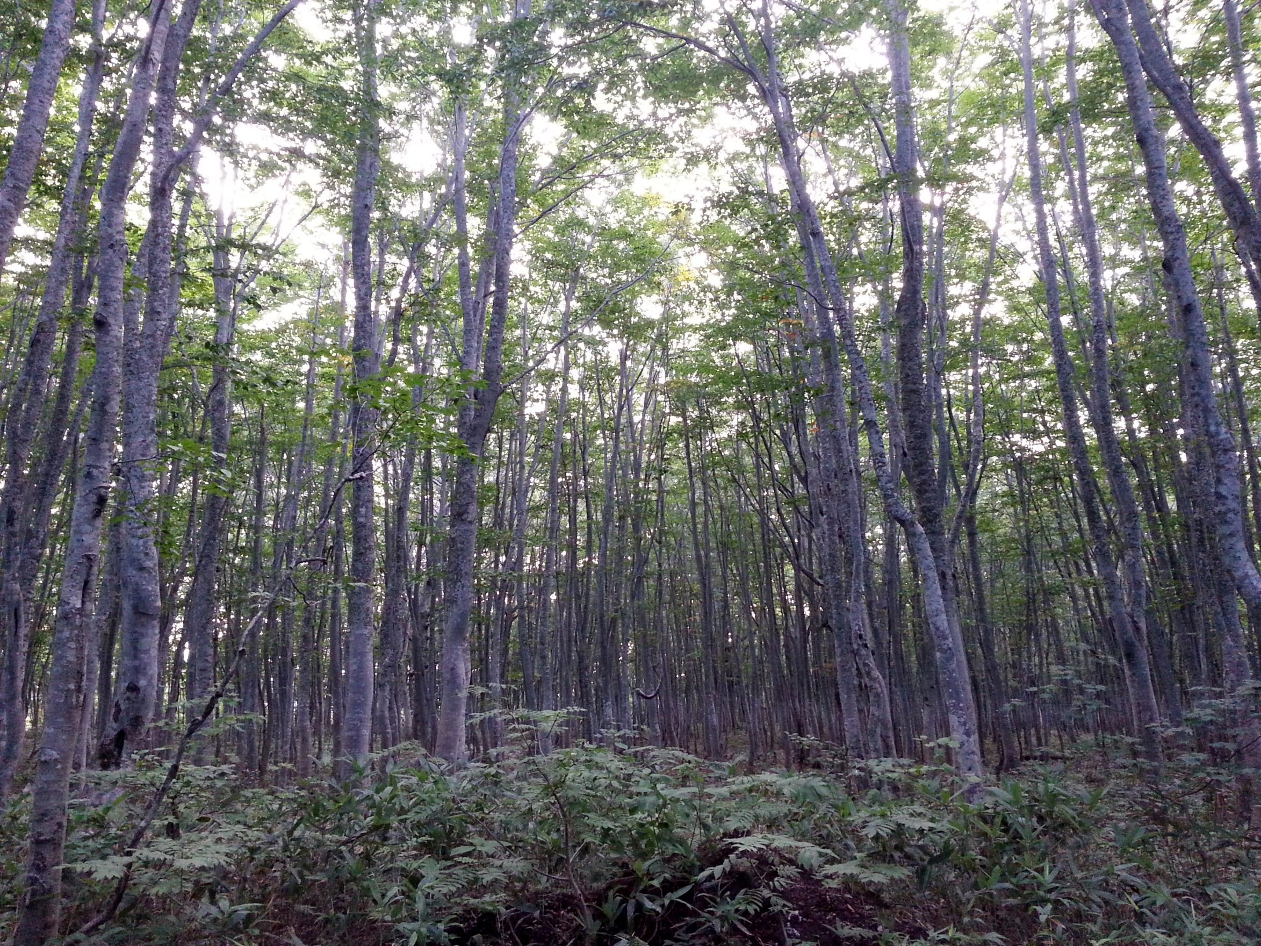
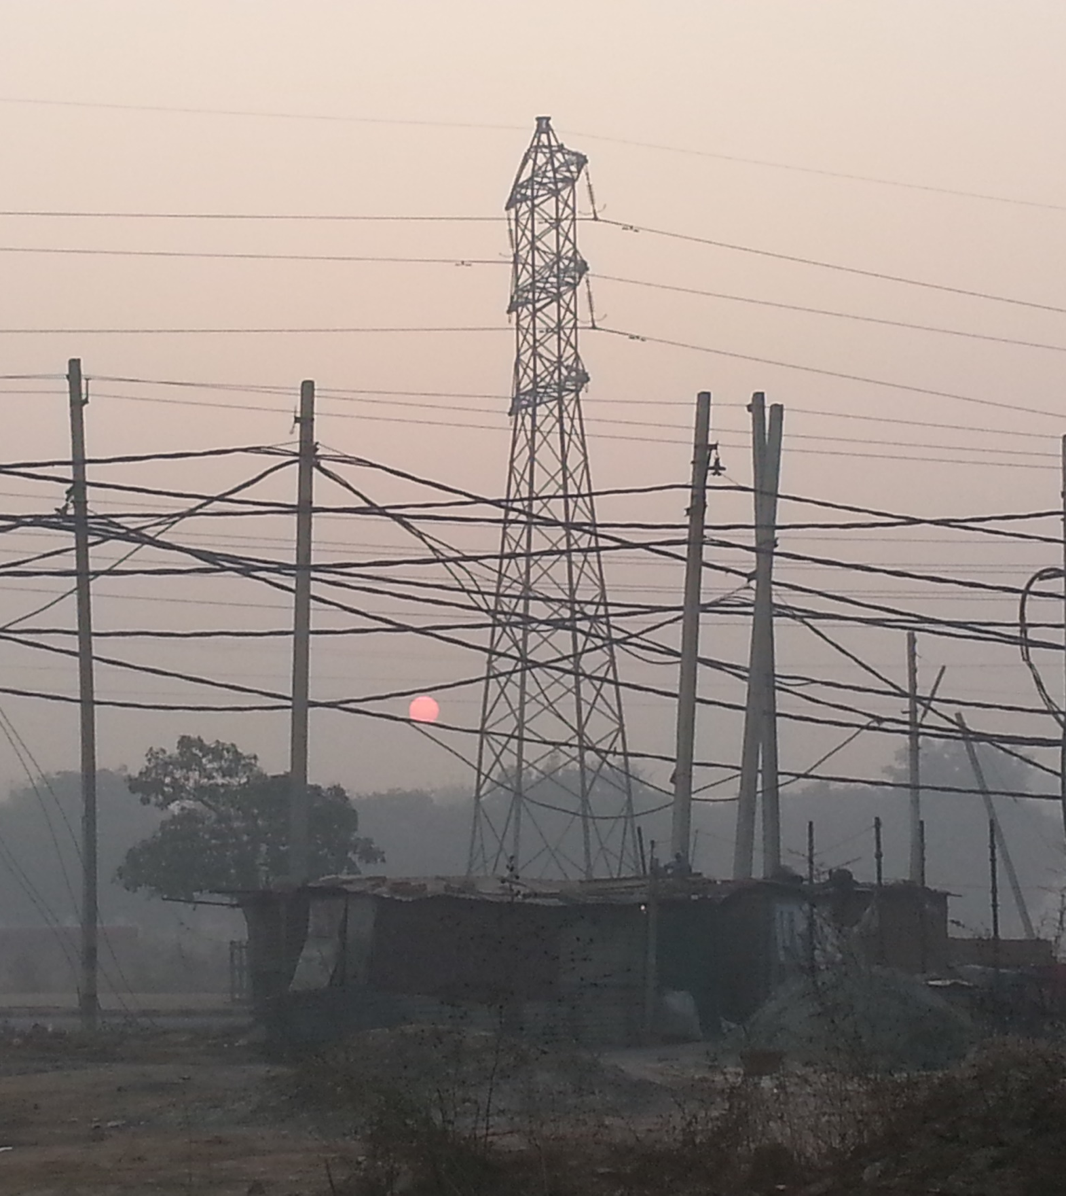
Notes:
We are connected to trees in the amount of paper we use or if you use paper towel to dry your hands (what’s wrong with a reusable cloth then we should only ever need one paper towel at MOST - https://www.ted.com/talks/joe_smith_how_to_use_a_paper_towel)
We are connected to pollution in the kind and amount of stuff we consume, what transport we use, the foods we eat, what we do with our litter, etc…
Pollution is made from humans (US!) and we are connected to it and are the ones who CAN, MUST and WILL make it better!

Slide 46
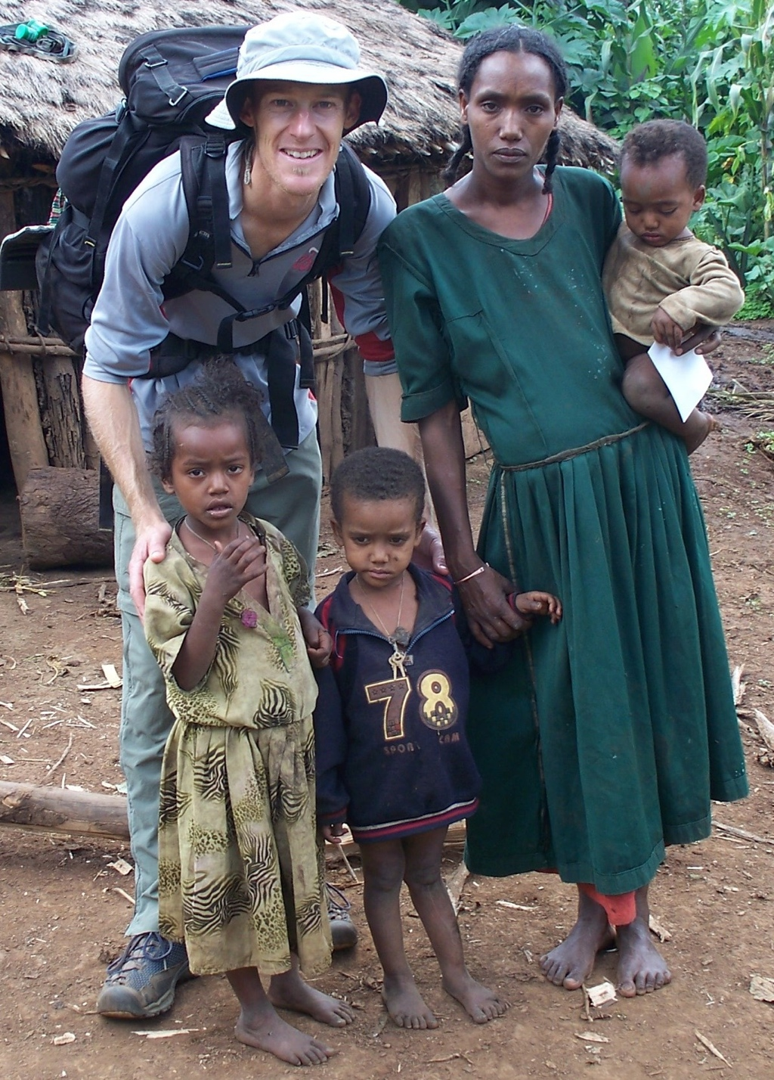
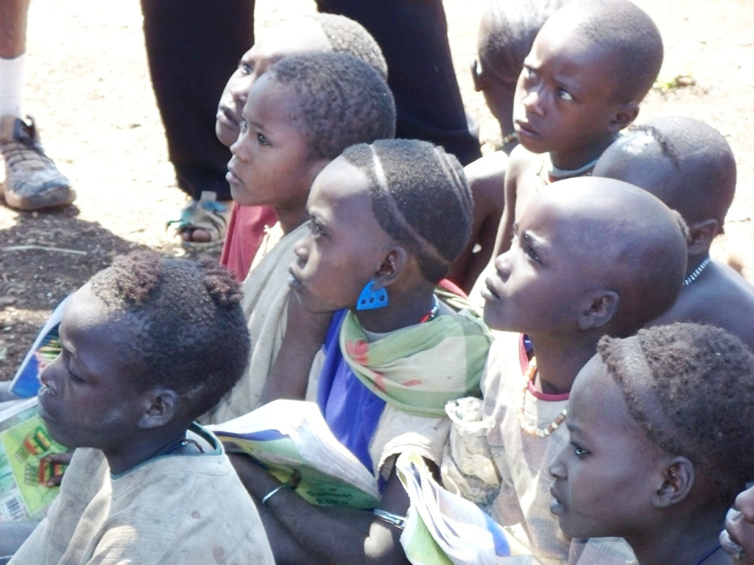
Notes:
Not only the environment but also people. These are some of the people I met while volunteering for a year in Ethiopia who were self-sufficient but dependent on the forests around them and the weather. Climate change hits the world’s most vulnerable people fastest and hardest so when we are working on combating climate change and protecting the planet we are also having a positive impact on communities.
The environment and people are always intricately linked.

Slide 47
WE ARE ALL GLOBAL CITIZENS!
Notes:
Congratulations! The universal and unquestionable fact is that: WE ARE ALL GLOBAL CITIZENS!
Anyone anywhere or everyone everywhere is a global citizen and we can start to now think about being a positive and effective global citizen

Slide 48
How can you be a good one?
Notes:
The important question is to ask is How can you be a good one?

Slide 49
Animation part 2 - Invent, innovate and campaign https://vimeo.com/178464378
Notes:
World’s Largest Lesson 2016 Animation part 2 - Invent, innovate and campaign… https://vimeo.com/178464378 (full 6min version)

Slide 50
Milkshake Handshake
INSPIRE • EMPOWER • ENGAGE
Notes:
Ask a volunteer and perform the dairy cow handshake... (this is where one person interlocks their fingers turns them upsidedown and sticks their thumbs down as well. The other person then grabs their thumbs and milks them like a cow. The person who is being milked like a cow then makes the noise of a cow).
Do the dairy cow handshake with the person next to you and get ready to discuss the question on the next slide.

Slide 51
Who do you think is a good one?
Notes:
Now think about who is a good one (global citizen)?
Think in your family, your school, your community or someone you admire for the work they do in making the world a better place

Slide 52
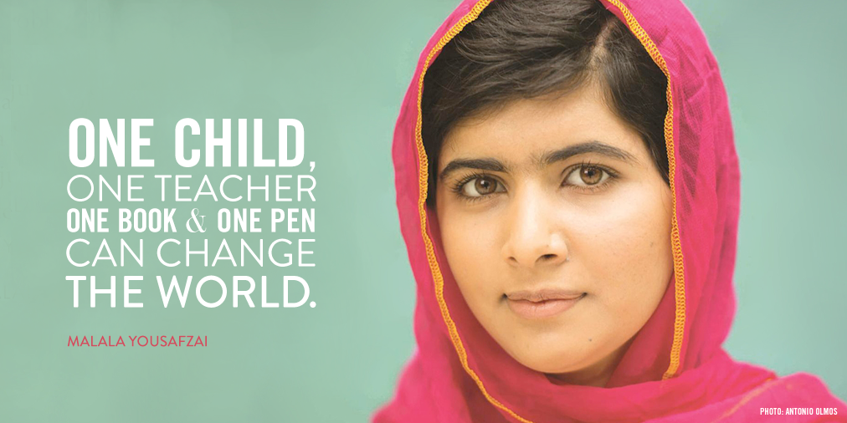
Notes:
We are so lucky to have a role model such as Malala Yousafzai. Just a young woman who isn’t rich, a sports star, a man, old, etc but is well known because she is passionate about every girl having their access to the right of education!

Slide 53
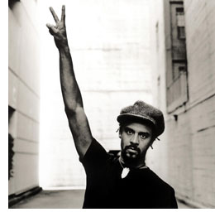
Self Reflection
Michael Franti,
Musician
‘Are you a part of the pollution or are you a part of the solution?’
Notes:
A really good filter and perspective for me to be a great Global Citizen comes from a role-model and mentor of mine called Michael Franti. He’s a musician with a band called Spearhead and in one of his songs he has this lyric: ‘Are you a part of the pollution or are you a part of the solution…’
So when I am doing anything I am always thinking about is this going to put help in the world or put harm in the world…

Slide 54
How does a global citizen create positive change…?
Notes:
Discuss: How does a global citizen create positive change?

Slide 55
Teaspoons of Change
一人一人の小さなへんかが人とちきゅうをかえていく
Teaspoons of Change - personal choices, decisions and actions that have a positive impact on people and the planet
Notes:
Well I have found that one of the best ways to create positive change in the world is through our own choices, decisions and actions which is why I created an idea called Teaspoons of Change - personal choices, decisions and actions that have a positive impact on people and the planet creating teaspoons of change

Slide 56
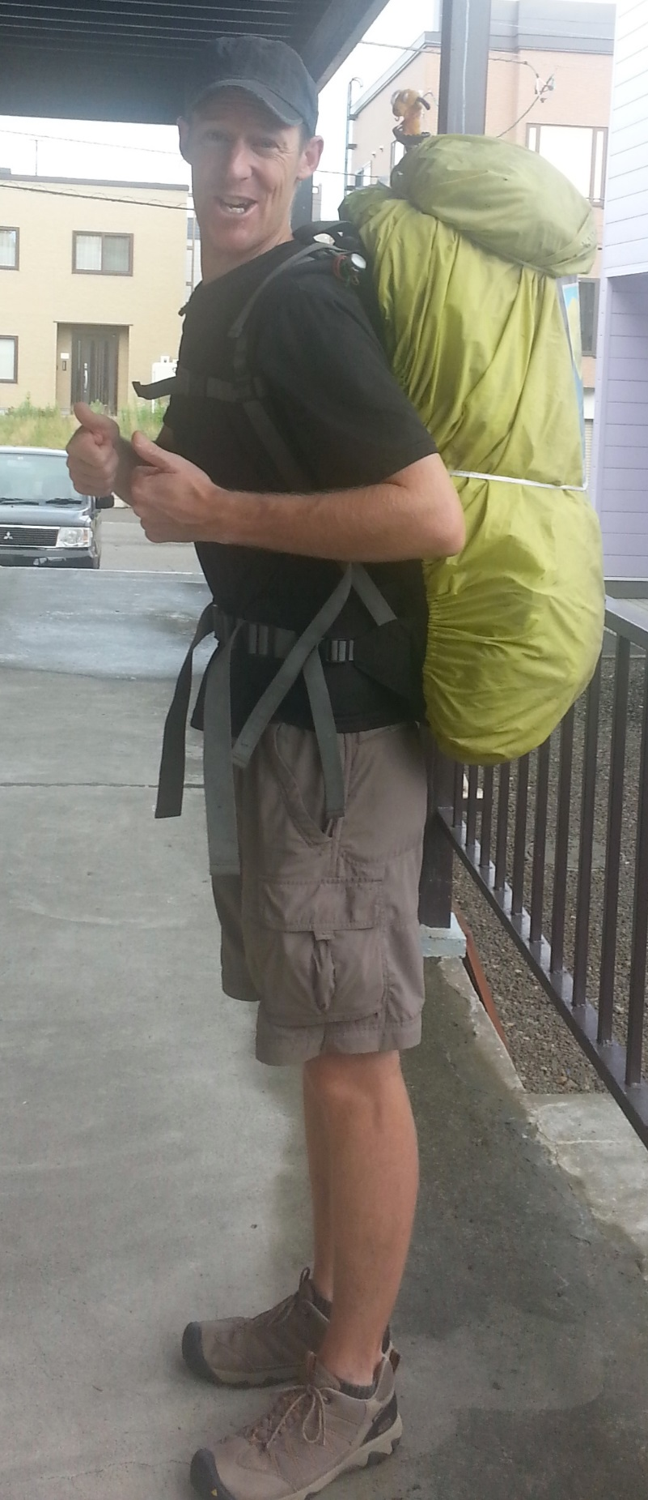
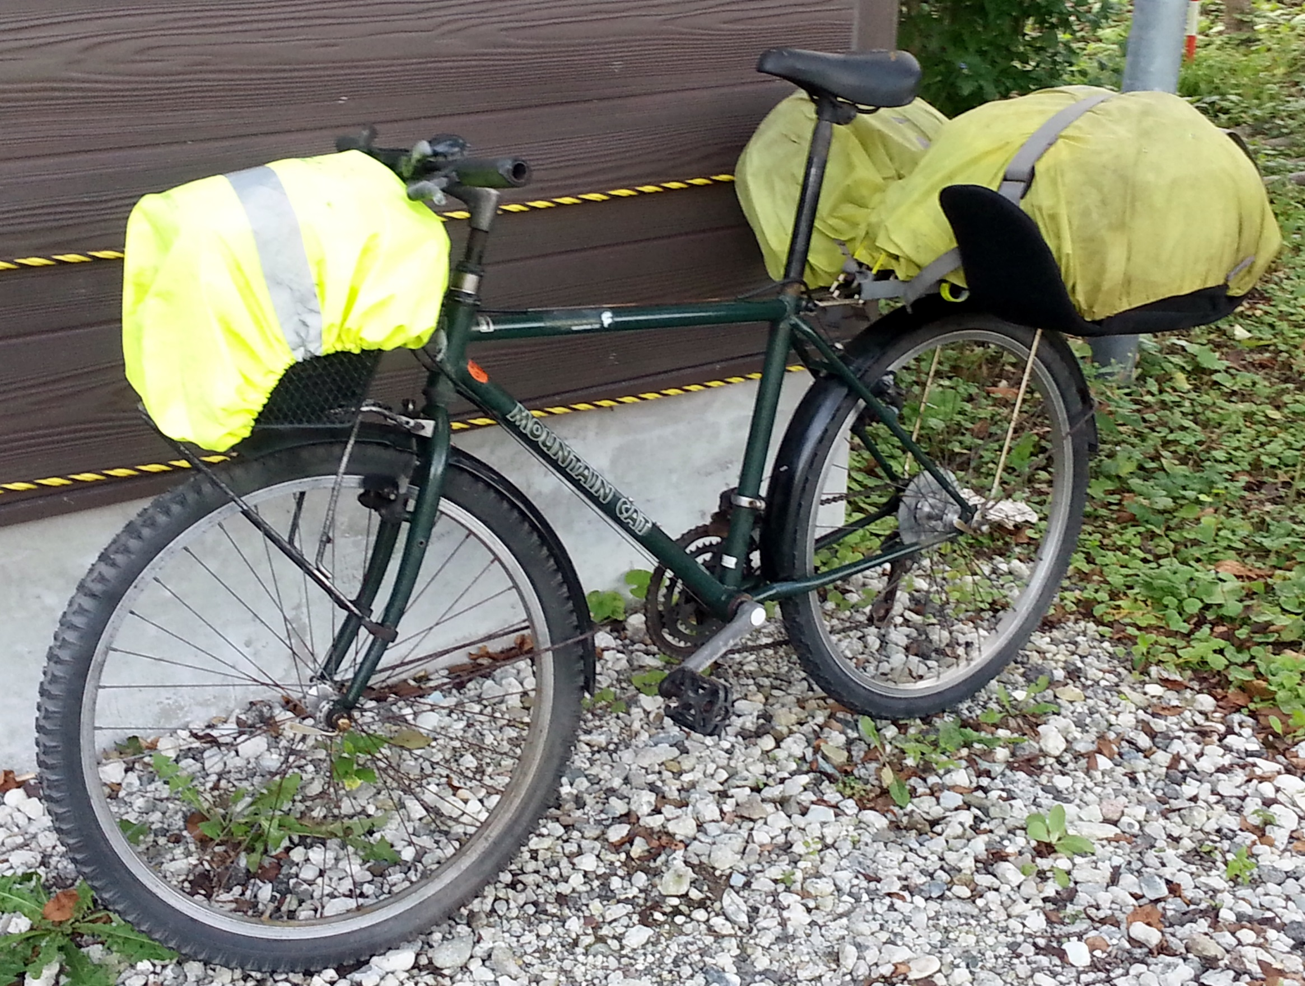
Notes:
In order to think of all the personal choices, decisions and actions I could make as an affective Global Citizen I went for a 1000km walk in Japan, until I got shin splints and then jumped on a bike and cycled another 1000km. When you walk and ride that far you have a long time to think and so I came up with as many Teaspoons of Change as possible and wrote a blog, Facebook updates and I’m writing a book.

Slide 57
A good
Wants to make as many:
      • Good Choices;
      • Good Decisions; and
      • Good Actions
that have a positive impact on people
and the planet
Notes:
So when you next have the chance to think on a 1000km walk or just stuck in traffic think about what are as many good choices, decisions and actions you can take to have a positive impact on people and the planet!

Slide 58

help
harm
Notes:
To help me do this I also started thinking about my personal balance of help I do in the world and harm I do in the world。。。

Slide 59
help
harm
Notes:
Please take the time now to write or discuss your personal helps you do in the world - not what you do for others but what you do on a daily or personal basis…
List the personal help and harm you think you do in your daily life…
Here are some of my helps and harms…

Slide 60
help
harm
Walk / ride a bike
Refuse plastic bags
Never buy bottled water
• Engage with representatives
• Rarely eat meat
Fly on planes
Buy cheap stuff
Don’t turn off laptop
• Shop at supermarkets
• Drink soda water
Notes:
This is just a list of my personal helps and harms for me to think about my own personal balance and output to the world through my own personal choices, decisions and action

Slide 61
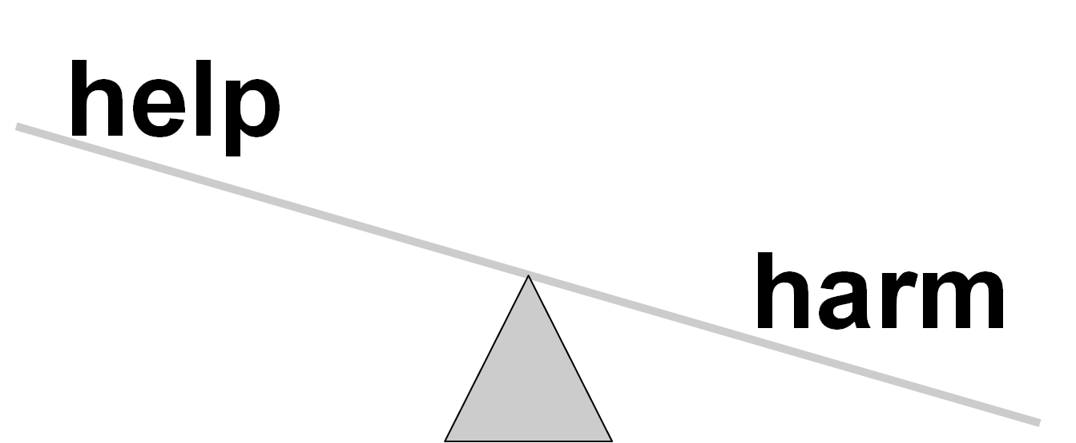
Notes:
We need to look at our balance and think about our help and harm and see if we are doing maybe more harm than help in the world

Slide 62
harm
help
Notes:
What we want to see is to flip this scale to be help heavy and harm light where we try to maximise help, and minimise harm.
One note is that we are always going to do harm so we shouldn’t feel too guilty and powerless by out harms, we need to look at it as opportunity to less hard and more good when possible

Slide 63
Wet Fish Handshake
INSPIRE • EMPOWER • ENGAGE
Notes:
Do the wet fish handshake and please find three separate people to practice and preform a wet fish handshake. Then stay with the third person to make a pair and make sure it is not someone who has been your handshake partner before.
After catching all those fish what can we do to make sure we don’t catch too many fish to make sure it is sustainable? (release fish, not eat fish, eat less fish - Fishless Friday, eat smaller fish which are more sustainable or only eat fish that is sourced sustainably)
If you are unsure of the wet fish handshake you have two people opposite eachother and they have a fishing rod each. They cast their fishing rods towards one another and then both reel in like they have caught a fish (and make the sounds effects). They extend their right arms and instead of shaking hands they slap one another gently on the inside of the forearm flapping and sounding like they have just caught a fish
Now in your pairs also discuss the following question:

Slide 64

Global Citizen Draw
What does a global citizen look like?
What do they:
Teaspoons of Change…
Help vs Harm…
Global Citizen Mindset…
Your own creative ideas!!
        Think?
        Feel?
        Say?
        Do?
Notes:
With our help vs harm, Teaspoons of Change and global citizen mindset lets now start to create that sharp picture of ourselves as an effective Global Citizen and what we think, feel, say and do…
So lets start with a picture of you as a Global Citizen

Slide 65

Notes:
Here we have a naked global citizen and we need to start adding attributes, qualities, actions and more for this to become an active and effective global citizen. Think back to the people we identified just before including Malala and Michael Franti…

Slide 66



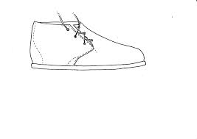
Notes:
First think about - what does a Global Citizen think…? (they think about others, they think about their own impacts, they think about their personal, choices, decisions and actions, they think about their help and harm balance, etc)
Next what does a Global Citizen feel? (they feel connected to others and the environment, they feel empathy towards others, they feel they can make a difference, they feel positive and optimistic, etc)
What does a Global Citizen say? (they share their ideas and learning with others, they learn more about topics to have more informed things to say, they speak with others to learn more and talk about topics and issues they care about, etc)
Lastly and most importantly what does a Global Citizen do? (they take action by supporting others already doing good work, they create ideas and solutions, they start or join campaigns, they take Teaspoons of Change and turn them into habits and they not only take action for themselves but share it with others, etc)

Slide 67
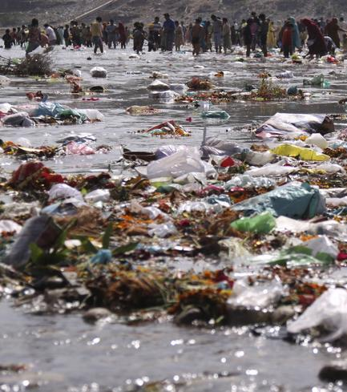
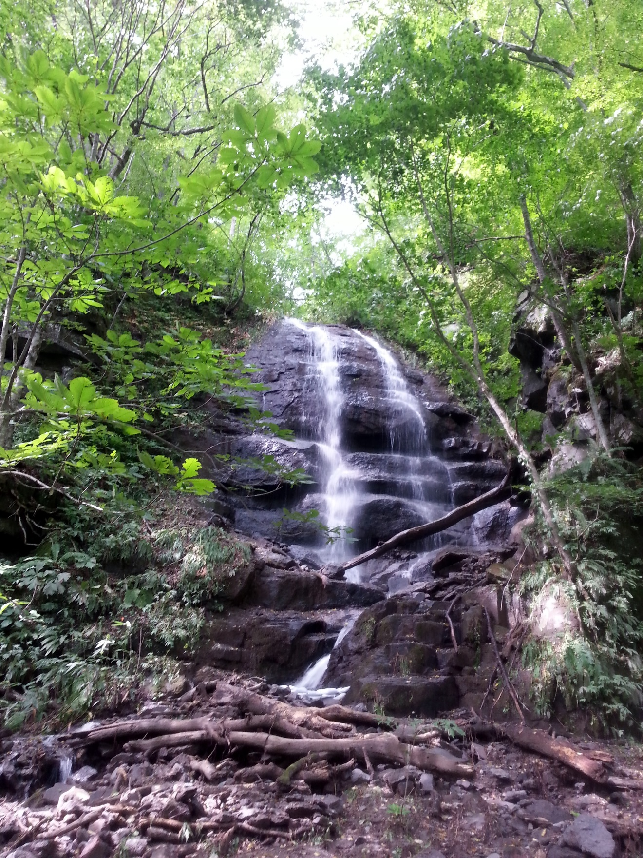
OR
Are you a part of the
Are you a part of the
pollution?
solution?
Notes:
And now imagine yourself as a Global Citizen - how are you going to think, feel, say and do as and active and effective Global Citizen?
Remember we are looking for Global Citizen who look for, create, support, find, deliver and act upon solutions when and where they see pollution…
(You might like to put some ideas into your personal Global Citizen booklets or do a quick sketch of all the best features you like of the Global Citizen group draws in front of you)

Slide 68
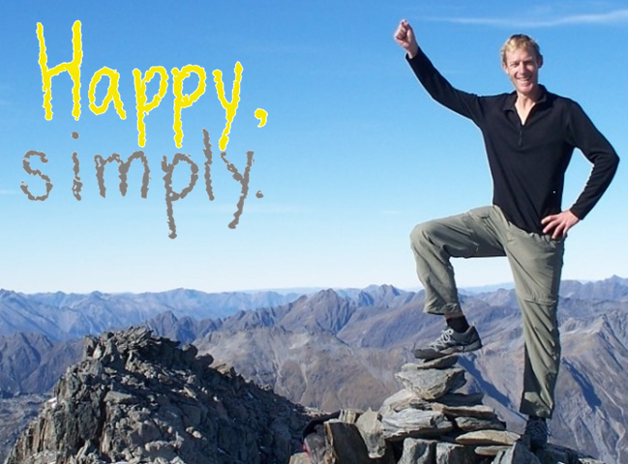
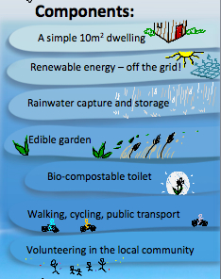
a sustainable lifestyle model and education project.
Notes:
To help compensate for a big harm that I do in the world which is to fly on aeroplanes I have created a project called Happy, simply that looks at simplicity, self-sufficiency and sustainability

Slide 69
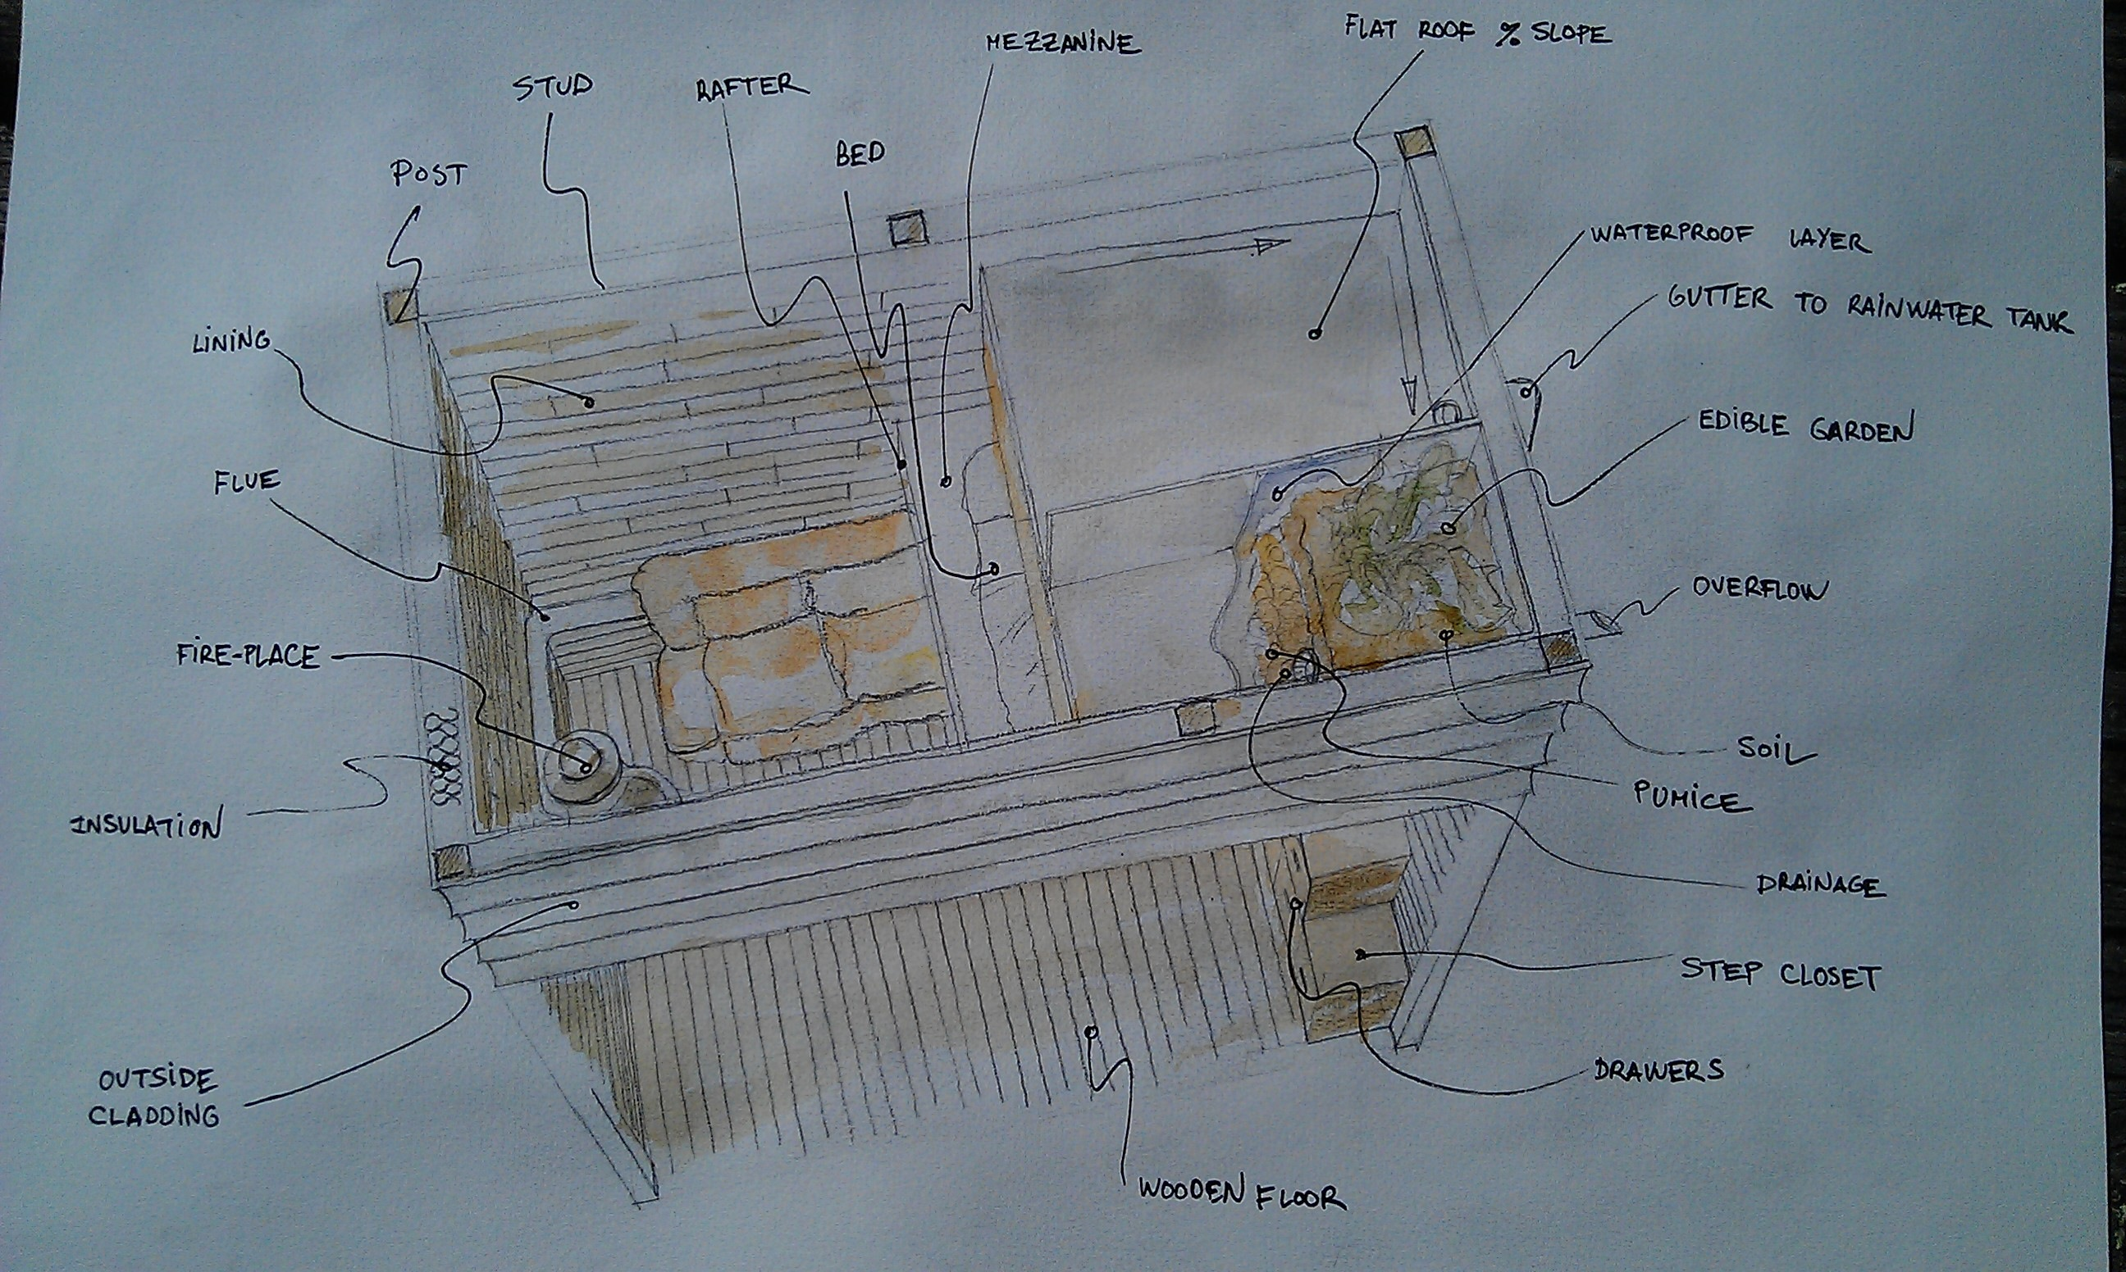
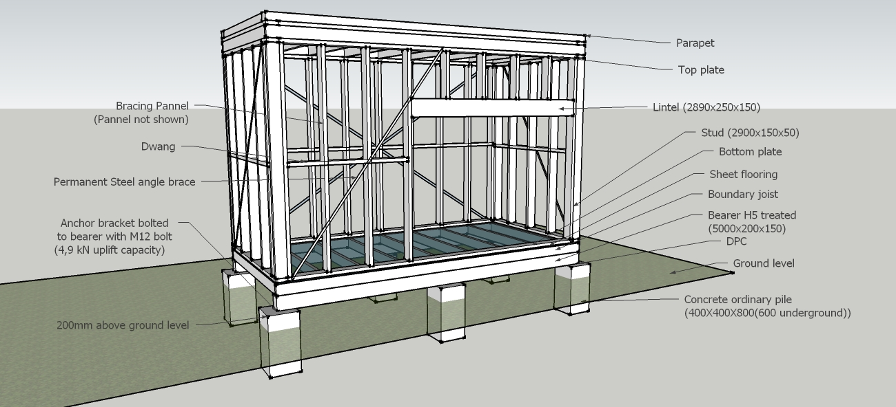
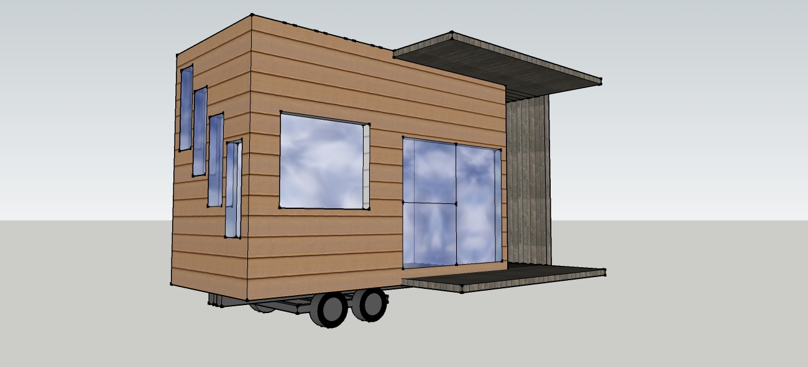
Notes:
This includes building a small self-sufficient house

Slide 70
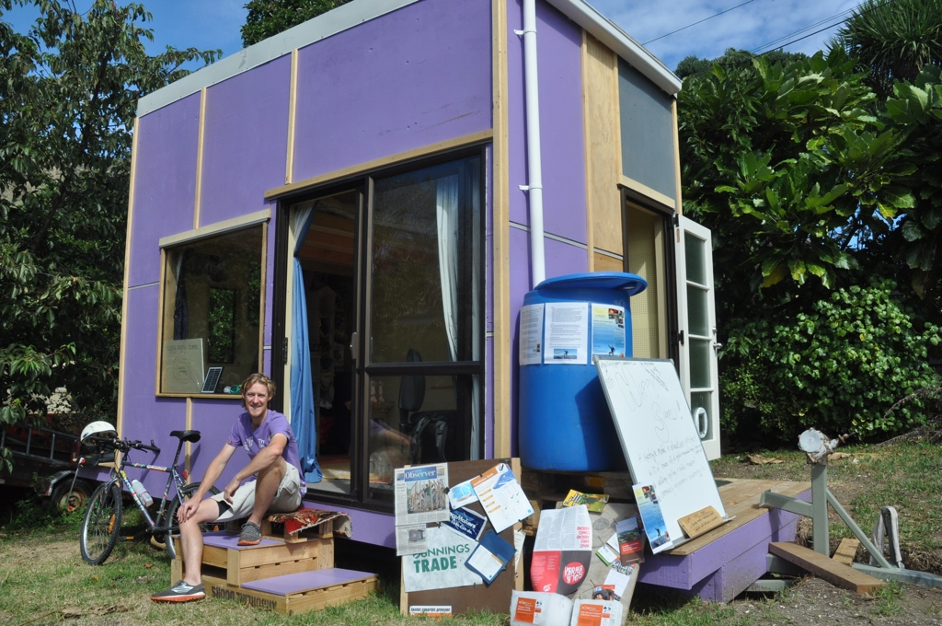
Notes:
One I built with a group of volunteers in Aotearoa New Zealand where I get my electricity from the sun through solar, I get my water from the rain in rainwater capture and all my waste goes back into the earth through a compost toilet

Slide 71
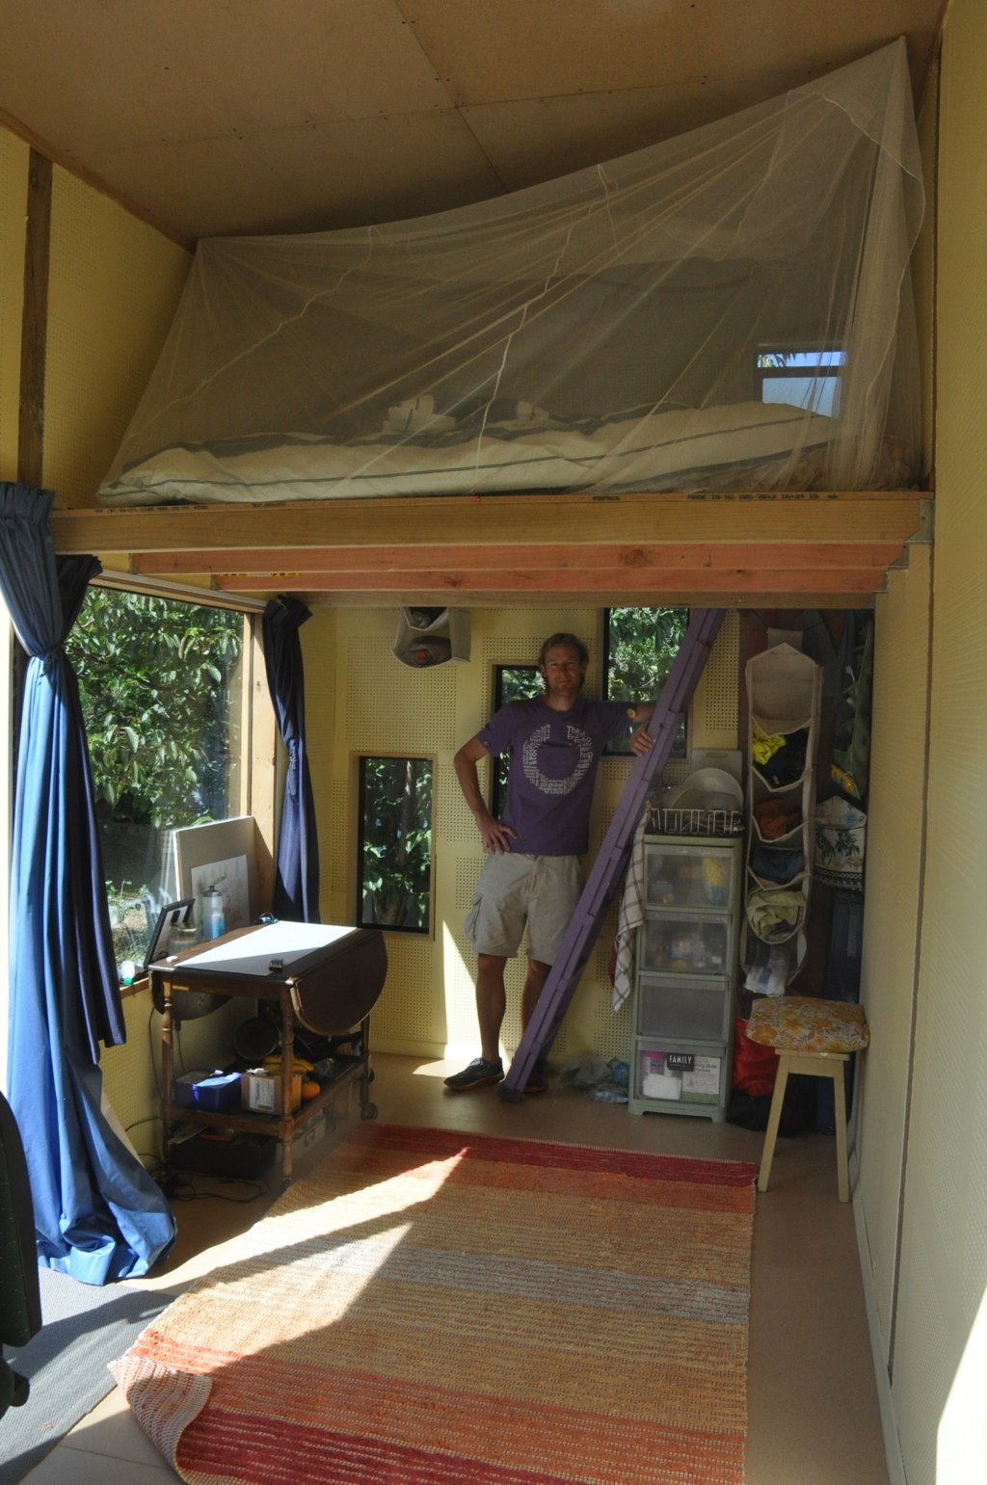
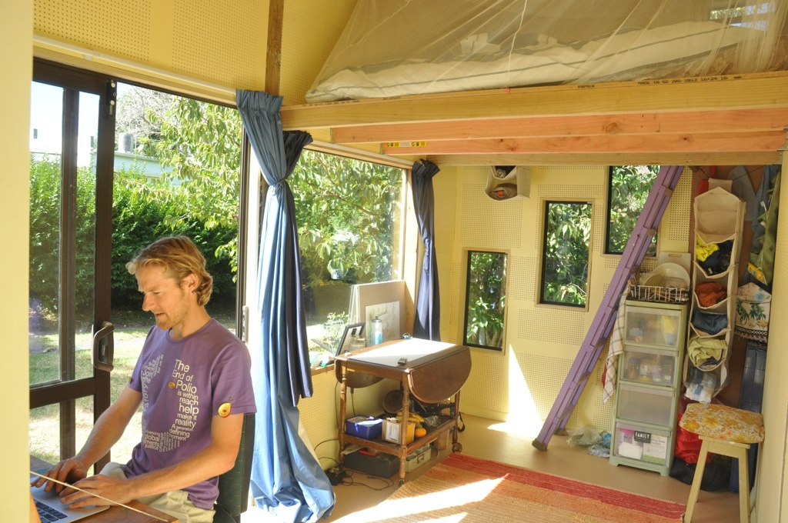
Notes:
Here is a picture of the inside of the home

Slide 72
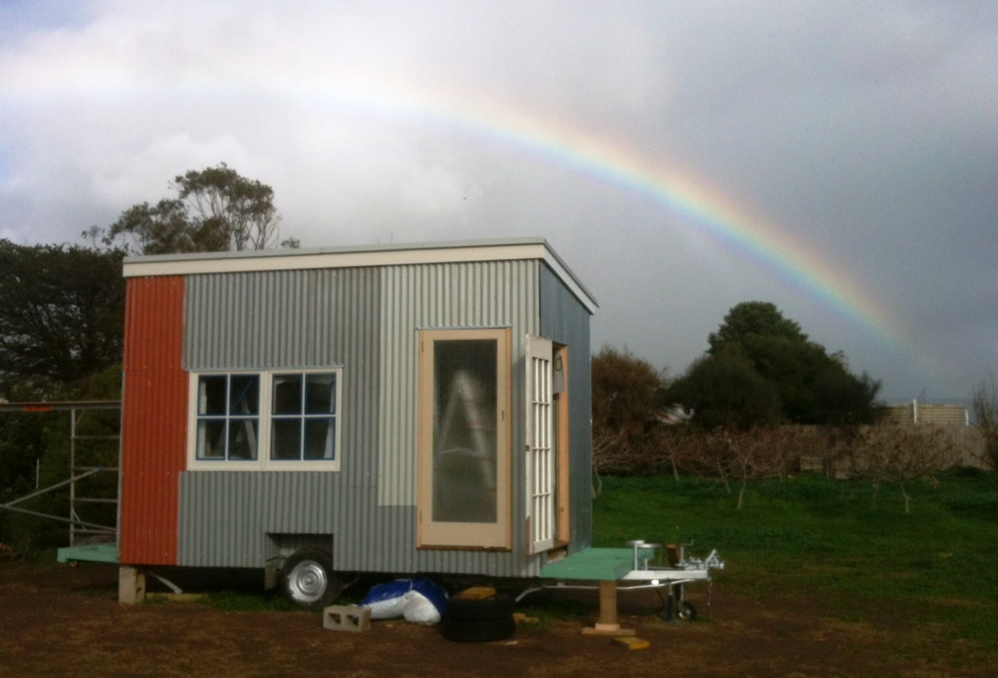
Notes:
And I built another in Australia (and it came with free rainbow!)

Slide 73
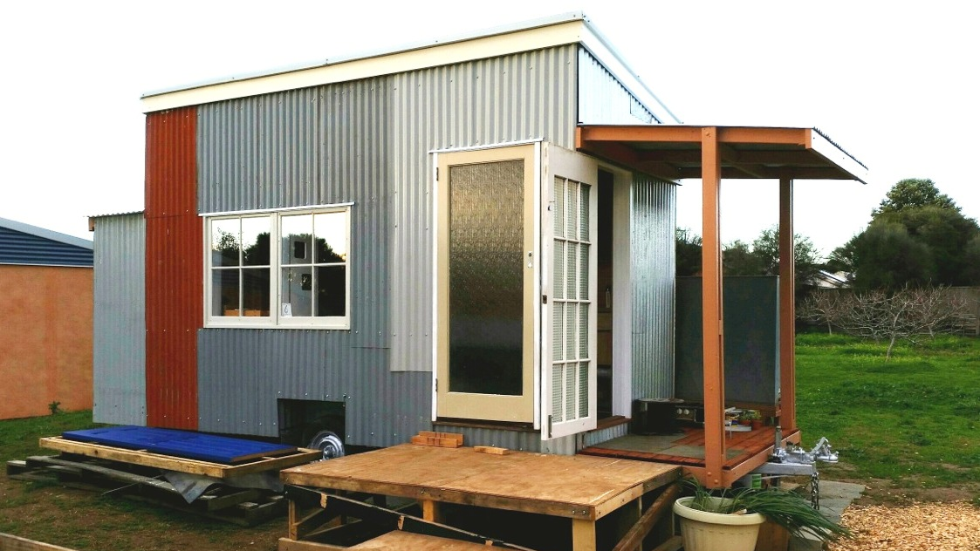
Notes:
Here is the completed home… and the only big difference is that I need a bigger rainwater tank because it rains less in South Australia than it does in New Zealand.

Slide 74
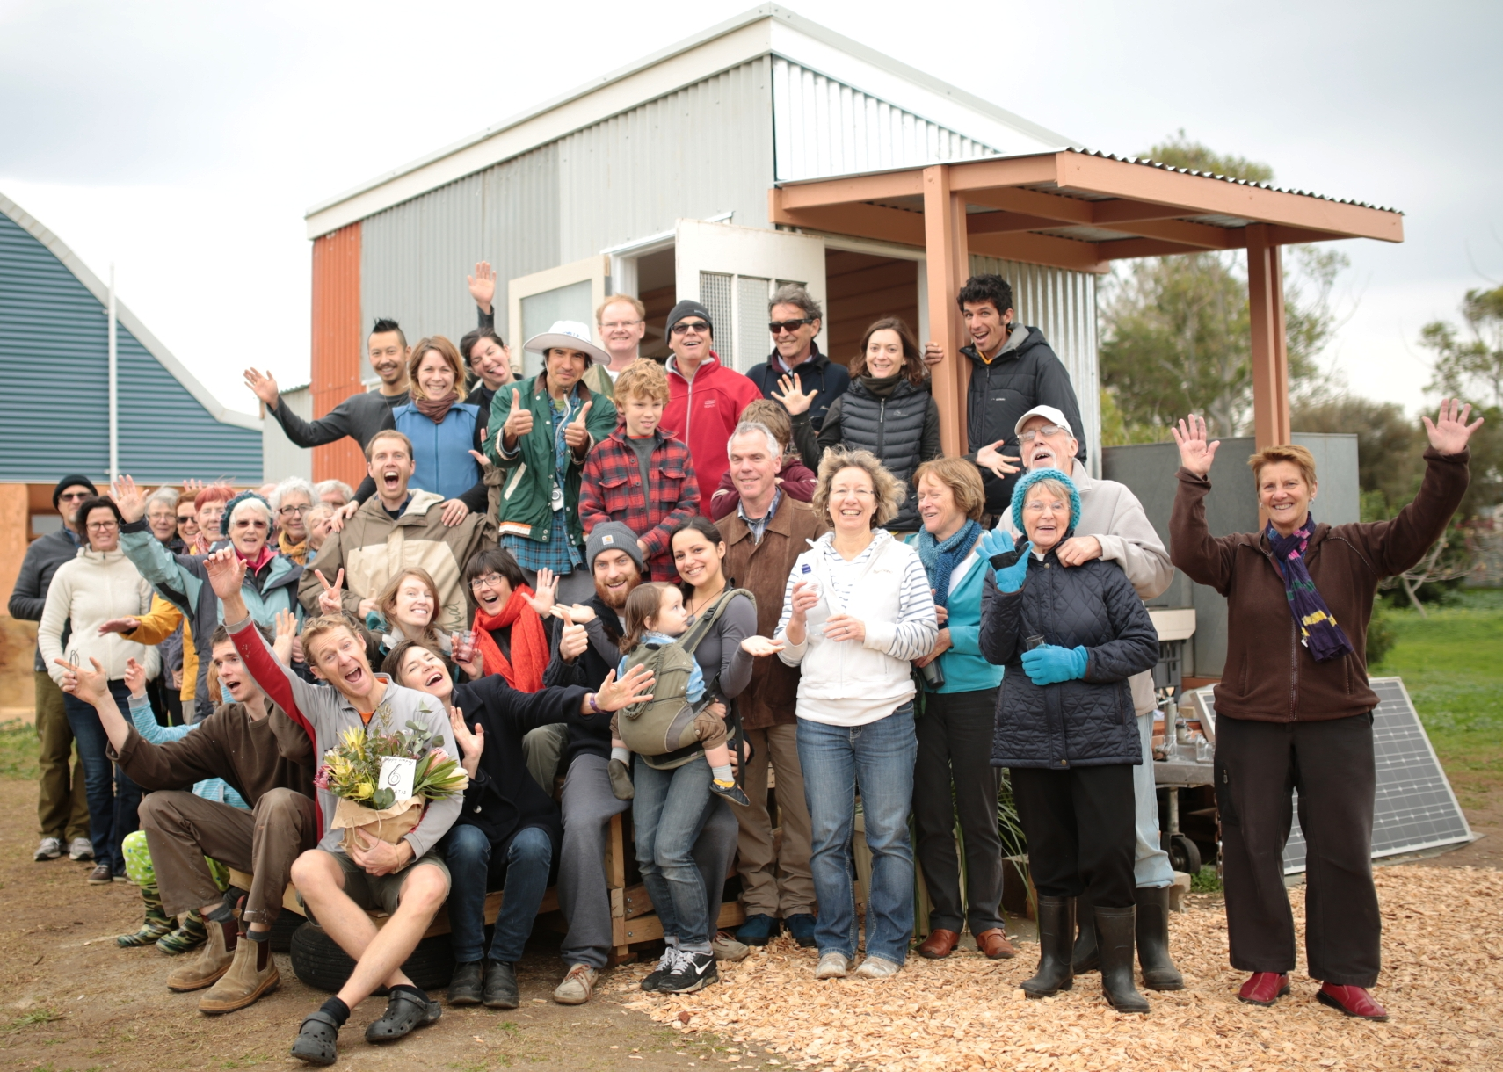
Notes:
The most important part for me was to bring community together. I now have a strong connection to those tiny houses and the communities around them.

Slide 75
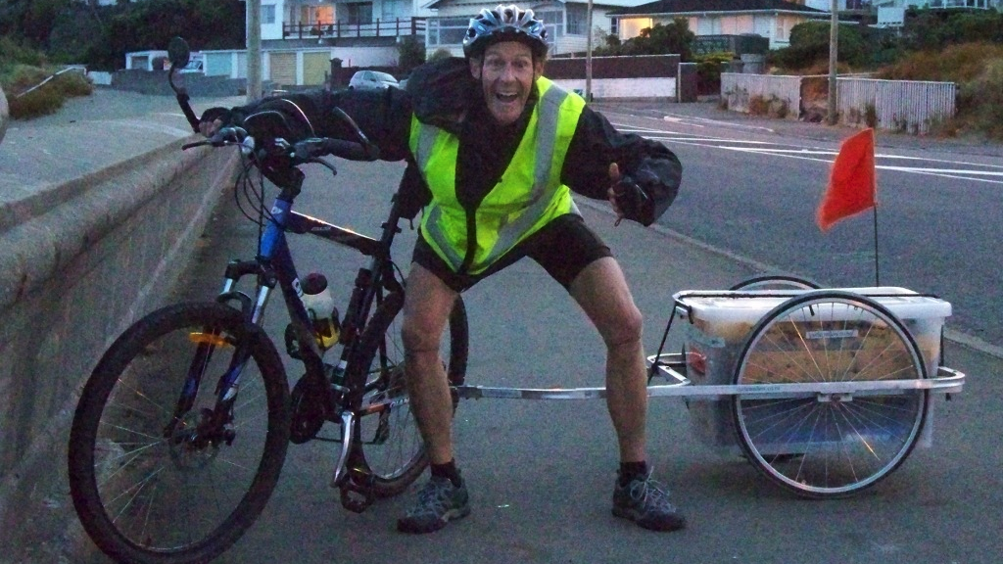
Notes:
Another way to put some more help into the world is riding a bike…
If we celebrate the help or Teaspoons of Change we can do then we will do it more often and find new ways to help.
(you don’t have to be this excited about riding a bike but I had just finished riding 4000km around Aotearoa New Zealand)

Slide 76
マイはし！
忘れないでね
Notes:
There are lots of other examples out in the world as well…
This is a character from Japan called My Chopsticks…
They always carry their chopsticks when going out for lunch and dinner so they don’t use the throwaway chopsticks

Slide 77
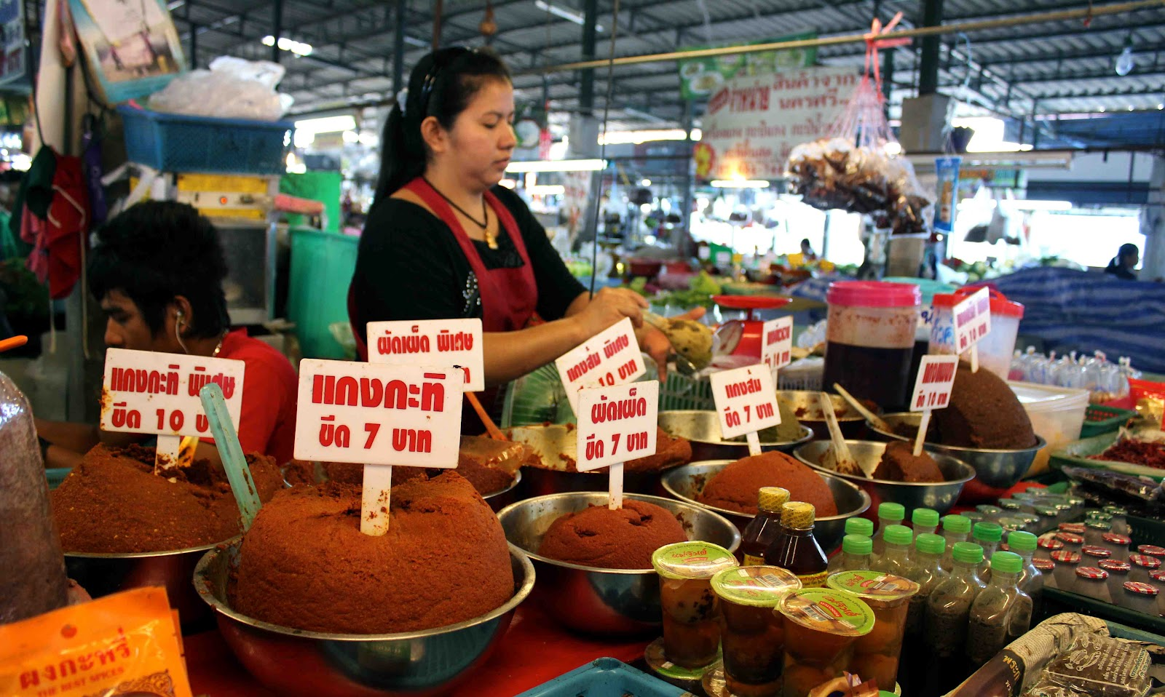
Notes:
Another easy way to add a Teaspoons of Change into the world is to support local people and local markets so the money goes to them, their family and back into the community unlike the money and profits from most supermarkets that go to a business usually overseas or out of your community. Local markets often sell fresh, local and seasonal products which is a great thing as well

Slide 78
Lumberjack Handshake
INSPIRE • EMPOWER • ENGAGE
Notes:
Please find a new partner and you will preform a Lumberjack handshake.
(Ask for a volunteer and demonstrate a Lumberjack handshake)
Please find three separate people to perform your lumberjack handshake and stay with your third partner to make a pair and discuss the following topic...

Slide 79
What are your
Teaspoons of Change… ?
Notes:
So a big question to you is this one…
What are your Teaspoons of Change?
Be sure to start with one right now. Tell it to someone or write it down but make sure you don’t just say it or write it, actually do it!!!

Slide 80
Teaspoons of Change
Charter for your home, class, school, workplace, holiday, etc…!
Notes:
Once you have thought about your own Teaspoons of Change you might like to create a charter for you own life, home, class, year level, school, workplace, holiday, etc.!

Slide 81
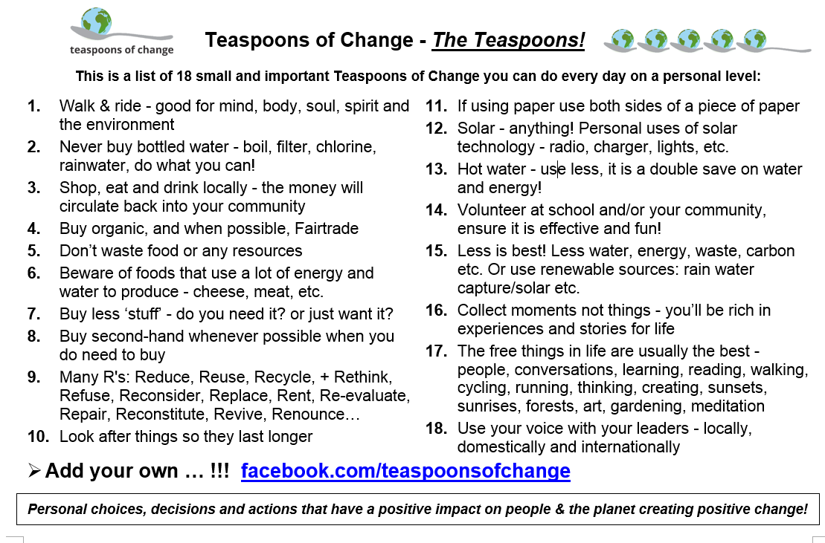
Notes:
Here are a few selected Teaspoons of Change from the website but you will be better at deciding the Teaspoons of Change that best suit you and your life. You can see a bunch of them on the Teaspoons of Change website: http://teaspoonsofchange.org and be creative and come up with your own and share them on the Teaspoons of Change Facebook page

Slide 82
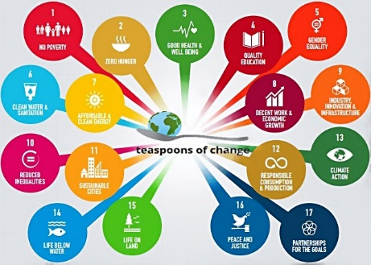
Notes:
Just know that any small Teaspoon of Change does have a bigger context and impact and is working towards the Global Goals for Sustainable Development! Acting personally and locally, impacting globally… That is how we solve this big issues is with Teaspoons of Change of actions to see it happen at larger scale…

Slide 83
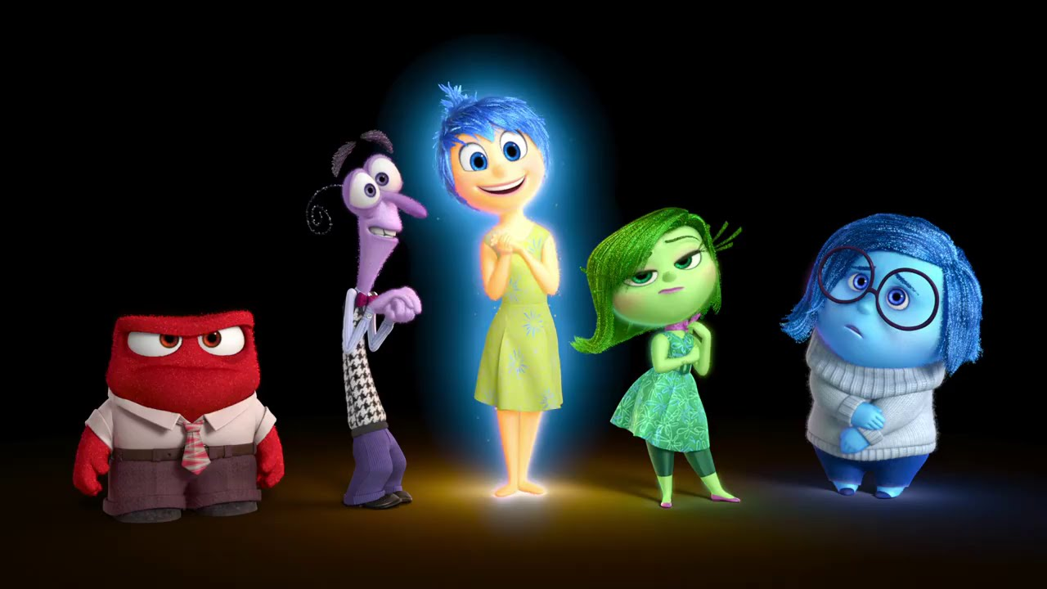
Who is an influence on you?
How might you be an influence on others?
Notes:
Lets have a look at influence.
Who is an influence on you? And How might you be an influence on others?
(if you have time discuss in groups, pairs or as a whole group or just use these questions to frame the following slides)

Slide 84


Outside → In
and
Inside → Out
Some of the most significant influences
we create are the ones
we will never know about…
Notes:
Influence can be in different forms and two common styles of influence is Outside → In and Inside → Out.
Outside → In influence is when we are trying to create change from the outside like writing letters to government or businesses, signing petitions, joining campaigns, etc
Inside → Out is where we have an influence on the people we know around us just by being who we are. Young people are a huge influence on their parents, we are a significant influence on our family and friends and I think this is where we also can play a big role in creating positive change.

Slide 85
Does any or all of this really make a difference!?
Notes:
So do any of these Teaspoons of Change or small actoins actually make a differnece...? Lets take a look

Slide 86
Online link to video: https://youtu.be/IGMW6YWjMxw
Notes:
I believe one drop in the ocean can make a difference and let’s take a look at a story about the hummingbird. https://youtu.be/IGMW6YWjMxw
As global citizen we need to believe we can take on big challenges, to face them and to do the best we can!

Slide 87
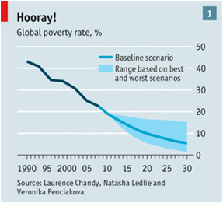
% of people living in extreme poverty
1981 – 52%
2015 – …?
2015 – 9.6%
2030 – 0%
Notes:
Here are a few stats for you from the World Bank…
Around the time I was born 37 years ago the percentage of people living in extreme poverty was 52% - more than half the world’s population lived in extreme poverty
Have a guess what that percentage was in 2010 (our latest statistics)…? Tell the person next to you.
I believe it is possible to see extreme poverty down to 0% by 2030 and you don’t just need to believe me, here are some other sources of information and inspiration

Slide 88
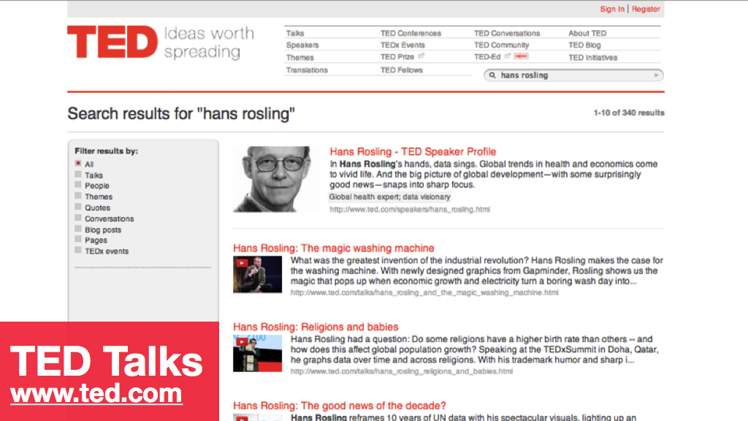
Notes:
TED talks are a great source of positive news and good people doing good things to see the end of extreme poverty.
One of my favourites is Hans Rosling a Swedish professor who gives us some great news stories - be sure to check out his talk on washing machines!

Slide 89
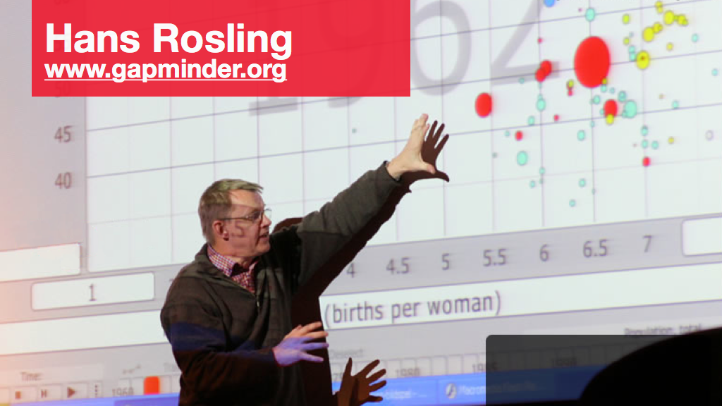
Notes:
You can also see Han’s work on Gapminder plotting graphs and showing the affect access to mobile phones has on infant mortality and other such wonderful graphs and statistics

Slide 90

Notes:
Do we know our flags…?
This is the flag of Ghana and Ghana is a good example of a nation in Africa who is working towards ending extreme poverty in its own country

Slide 91

(in Ghana)
Notes:
But ending extreme poverty isn’t about everyone have big TV and driving fast cars, it’s about the simple things in life, like having access to clean water where people can drink the water, not get sick and be able to work or go to school

Slide 92
What is stopping us from
ending extreme poverty?
Notes:
What do you think is stopping us from ending extreme poverty?

Slide 93

Notes:
Sometime we might think we are helping when maybe we aren’t… Good intentions don’t always ensure good outcomes.
There is something in this photo that is an example of bad aid - what do you think it is?
This is a school in the Highlands of Guatemala that I used to visit once a week on a big loop hike. Every time I went they were always using a crappy blackboard at the front of the class so I asked Sergio, the teacher what was the deal with the whiteboard. He said ‘yes, it was a donations from the United States’, ok so why don’t you use it? ‘we did it was fantastic!’, so why didn’t you continue to use it? ‘because we don’t have those special pens…’
They can’t get whiteboard markers in the highlands of Guatemala. It is not that people didn’t care its that they needed to listen to the needs of the people rather than just helping the poor people…
その学校の中にはきふでもらった物があります。この写真の中できふでもらったけどあまりよくなかった物がありますがそれは何だとおもいますか？なぜよなっかたと思いますか？

Slide 94

Notes:
An incredible example of good aid is the near eradication of polio…
Polio is a virus/disease that can be prevented with two drops or an injection of vaccine.

Slide 95

Notes:
State of the world in 1988 for polio eradication. In 1988 there were still 125 countries endemic with polio. In 1988 there were 350,000 cases of polio, almost 1000 every day. In 1988 the Global Polio Eradication Initiative (GPEI) was formed comprising of Rotary International, World Health Organisation, UNICEF and Centers for Disease Control with the Gates Foundation joining later.

Slide 96

Notes:
This is the progress of polio eradication since 1988…
Just two countries on the endemic list - Pakistan and Afghanistan and the number of cases…

Slide 97

Notes:
Two drops multiplied by billions has seen polio cases go from 350,000 cases in 1988 to just 223 cases in 2012! Then in 2015 we had under 100 cases worldwide!

Slide 98

Cases in 2015:
Just 74! WORLDWIDE!
Cases in 2016:
HOW MANY???
Notes:
From 350,000 cases of polio in 1988 to just 74 in 2015 for the whole world, for the whole year!
In 2016 it has dropped even further with just 34 cases by 9 December 2016 (update stats if you have them)

Slide 99
Notes:
2015 had the lowest number of cases ever and by the end of April in 2016 the world has just had 10 cases… will 2016 be the last year for a polio case?

Slide 100
Notes:
For me to play a role in polio eradication I’ve been lucky to work on-the-ground and also start a project called Polio Points where students in schools do good things, they are awarded points and those points are matched by donations from a donor and the donations go to the polio eradication program.
It helps make a difference locally and globally!

Slide 101

WHAT ARE Polio Points?
Notes:
So what are Polio Points?

Slide 102

Polio Points is an award and reward system:
Matching local actions with donations having global impacts
Adding value to donations, giving them a local context and doubling the impact
Acting locally impacting globally
Notes:
Polio Points is an award and reward system that aims to create and promote local and global awareness, attitudes and action while at the same time saving a child from the perils of polio

Slide 103

Notes:
The formula is simple.
→ Do good things in school (Teaspoons of Change) as an active and effective global citizen and earn points from teachers and the school
→ The points are rewarded by being matched with donations from a donor
→ The donations go to on-the-ground work for polio eradication!

Slide 104



Save a child from polio
Earn
Reward

Slide 105



People do good deeds locally creating ‘Teaspoons of Change’ and are awarded Polio Points
Polio Points are matched with donations to polio eradication
A vulnerable child receives 2 polio drops and is vaccinated

Slide 106



Students at International School Brunei earn points from teachers
Standard Chartered Bank Brunei rewards 4 points with a $1 donation
Donations go to on-the-ground polio eradication with UNICEF Pakistan
Notes:
At International School Brunei students earn points; Standard Chartered Bank Brunei matches every 4 points with a $1 donation and the donations go to UNICEF Pakistan where a vulnerable child is immunised!

Slide 107



Slide 108

Notes:
Polio Points uses the Vivo online platform to record, view and share Polio Points earned as an individual, as a group and as a school or organisation!

Slide 109

Get in touch & find out more…
poliopoints@gmail.com
http://makingthepoint.org/
Facebook: Polio Points
Twitter: @PolioPoints
Notes:
If you want to know more about Polio Points, look up the website http://makingthepoint.org/ Facebook https://www.facebook.com/pages/Polio-Points/1437779323181745 on twitter https://twitter.com/PolioPoints and get in touch via email poliopoints@gmail.com !!

Slide 110

Notes:
The students at Bromsgrove International School Thailand, where Polio Points also is run, helped vaccinate this child in Pakistan and it is a beautiful thing to be a part of as they engage intimately with one cause in the world that of course feeds into the Global Goals and to see an end to poverty by 2030!

Slide 111
Intent
& Impact
Notes:
If we are in the process of trying to do ‘good’ we need to make sure we are thinking about intent and impact.
Is the intention for delivering a service or support or is it to listen and work with people with a strong commitment and intention to see long-term and effective impact?

Slide 112
Good Intentions
=
Good Outcomes
Notes:
We also need to be absolutely sure that our good intentions = good outcomes.
This means our ideas and intentions are not good enough, it needs to be matched with the needs and ensure it is for the outcome of those being supported not those supporting

Slide 113

Notes:
There are a few key points to be an active and effective Global Citizen and to be optimistic about ending extreme poverty…
Number 1 is we know what it takes. There are no mysteries around the things that work to make positive contributions to people and the planet

Slide 114

Notes:
Two is that it’s affordable to see a better world for all and the planet.
For example…

Slide 115

Notes:
We spend twice as much on bottled water than it would cost to make sure we all had access to clean water for everyone in the world

Slide 116

Notes:
But most importantly is that we can do it together!

Slide 117

Notes:
Its going to take vulnerable people themselves, rich people, powerful people and those who work in aid and development but more importantly it is going to take…

Slide 118

Notes:
People like you and me to do what we can and make Teaspoons of Change for betterment of people and the planet!

Slide 119

Notes:
There are lots of things we can do as global citizens…

Slide 120



Notes:
We are very lucky to have a new global framework to help try and overcome the biggest challenges in the world… the Global Goals for Sustainable Development.

Slide 121

Notes:
These Global Goals are a follow on from the Millennium Development Goals which took us from 2000 to 2015.
Each of these 17 goals helps us work together as a global community to ensure everyone, everywhere has access and opportunity to simple things like health, education, sanitation, peace, to protect and preserve our environment and to ensure equality by responsible consumerism and reducing inequalities

Slide 122

Notes:
The Global Goals for Sustainable Development are a big step up from the Millennium Development Goals and here are some of the main differences explained in this info-graphic

Slide 123

Notes:
I have a personal passion for education and know that all of the Global Goals are absolutely linked to education. Be sure to know more about the role of education and achieving quality education for all. Check out the Global Partnership for Education and their role in bringing us all together to work towards universal primary education, greater numbers of girls in school (particularly high school) and ensuring teachers are well paid and respected for their important roles in the community and the life of children and young adults.

Slide 124
Notes:
Basically the more we know about these goals the better equipped we are to tackle the world’s biggest challenges both locally and globally.
Anything we do should be in support of this framework and we can keep our people, businesses and governments accountable to these goals to see an end to poverty, reduce inequality and ensure environmental sustainability by 2030...

Slide 125

Notes:
To help launch the Global Goals at the United Nations General Assembly at the end of September last year there was a massive effort to get the Global Goals seen by as many people as possible through radio, SMS, TV, film and more… This project was called Project Everyone and I hope you can help share the Global with others after today!

Slide 126

http://www.globalgoals.org/worldslargestlesson
Notes:
The effort for the Global Goals to been seen by every student in the world is called the World’s Largest Lesson. Last year there was a huge reach but we need EVERYONE to have heard about the Global Goals in schools. Each year it comes out in September around the time of the United Nations General Assembly and highlights the goals and what we can do to take action!

Slide 127
Introduction video from Emma Watson: https://vimeo.com/174213067
Notes:
Introduction video for the World’s Largest Lesson in 2016 from Emma Watson: https://vimeo.com/174213067

Slide 128

Notes:
The World’s Largest Lesson for this year: From Where I Stand - a look at the Global Goals, what are they, what actions we can take and a focus on gender equality with an important task in the lesson…

Slide 129

Notes:
For this lesson we will focus on Global Goal number 5 - Gender Equality. You can do lots of lesson plans on any of the other Global Goals as well if you wish, just visit http://worldslargestlesson.globalgoals.org/

Slide 130
Stand up if you think there is gender inequality in the world?
Notes:
Please stand up if you think there is gender inequality in the world?
Let me know why you think there is or isn’t gender inequality in the world…

Slide 131
Discuss with the person next to you…
What difference do you think it might make to the world if there was gender equality?
What difference do you think it might make to you?
Do you feel you can make a change in the world toward gender equality?
Can you think of someone who is a role model for gender equality?
Notes:
With the person next to you discuss the following questions… (give the questions one at a time giving participants 1-2 minutes to discuss each one)

Slide 132
1. Break Through Male Privilege
2. Undo Society Around Us
3. Ensure Female Perspectives
4. Walk The Walk
Notes:
These a few steps I made for a TEDx talk I gave in Dubai in Oct 2016 looking at how males can support gender equality - here is a very brief summary of ideas and actions

Slide 133
Online link to video: https://youtu.be/sZQ2RUFd54o
Notes:
Link to Global Girls Spice Girls video from Project Everyone

Slide 134
WARNING: Please switch ON your mobile phone!
#FromWhereIStand
Twitter: @TheWorldsLesson
Facebook: TheWorldsLargestLesson
Instagram: @theworldslesson
Notes:
Please turn on your mobile phone or open your laptop and take note of these social media links…
If ok with the teacher and your classmates, you can take photos of you participating in the World’s Largest Lesson and post them online tagging the World’s Largest Lesson so they can see you and your country is participating!
You will also need to connect to your phone or laptop later to do the online survey.

Slide 135
Time For Action!
https://worldslargestlesson.globalgoals.org/
FromWhereIStand/index.html
or
https://goo.gl/BwiWEY
or
Look up World’s Largest Lesson
Notes:
Get out your phone, laptop or anyway to access the internet and go to any of the following…
https://worldslargestlesson.globalgoals.org/FromWhereIStand/
https://goo.gl/BwiWEY
Or look up World’s Largest Lesson on the web and go through to the survey on gender equality

Slide 136

Notes:
No matter what you need to get to this page and then click on the orange + Participate button.

Slide 137

Notes:
Sign in either individually or as a whole class

Slide 138

Notes:
Fill out some basic details and then answer the questions in the survey about the gender of the decision-makers in your life, community and country…
As you answer, the ratio of female and male will be calculated for you.
Submit your answers.

Slide 139

Notes:
Here are the survey questions…

Slide 140

Notes:
Take note of your final ratio as you submit your results

Slide 141
Share!
@TheWorldsLesson #FromWhereIStand in #(write country) my gender ratio is (women) : (men) #GlobalGoals
Twitter
https://twitter.com/Theworldslesson
Facebook
https://www.facebook.com/TheWorldsLargestLesson
Instagram
https://www.instagram.com/theworldslesson
Notes:
Share your results on social media to show and compare with others from around the world

Slide 142

Notes:
Once you have submitted your survey results and shared them be sure to look at the interactive map on the site to see the gender ratio of other students from around the world…

Slide 143
What did you discover?
What’s your ratio? Is it the same as your hypothesis?
How does your community compare with the global average? What does this mean for your community?
What are three things you think you might personally be able to do?
Create a class action plan and put it into action!
Be sure to check out more resources on WLL…
Notes:
As a class or small groups or in pairs have the students discuss the following questions…

Slide 144

Notes:
Resources on the World’s Largest Lesson website http://worldslargestlesson.globalgoals.org/

Slide 145
Notes:
Reflect back on the Global Goals from the start of the lesson and see how easy and important it can be to take action working towards achieving the Global Goals

Slide 146
http://www.globalgoals.org/worldslargestlesson
Notes:
Thank you for participating in the World’s Largest Lesson for this year. The statistics collected from this survey will be used at significant UN meetings and with governments to work on gender equality and ensure a better balance of decision-makers in our communities and countries…

Slide 147
Resources, Learning and Action
WLL: http://worldslargestlesson.globalgoals.org/
Global Goals: http://globalgoals.org/
HeForShe initiative: www.heforshe.org/
UN Women: www.unwomen.org/
UNICEF: www.unicef.org/
Notes:
Here are some final resources, sources of learning and more ways to take action:
World’s Largest Lesson, Global Goals, HeForShe, UN Women and UNICEF

Slide 148

Notes:
In Australia we have the Campaign for Australian Aid which is aiming to create more awareness around the importance of Australian Aid and to see Australian Aid increase on some of the lowest investments in the Australian Aid budget for decades

Slide 149


Notes:
The Campaign for Australian Aid consists of a huge coalition of organisations, businesses, faith groups and more - all supporting Australia to be the giving and generous country and people we pride ourselves on being

Slide 150
Aid budget cuts
in just one term of govt = $11b+
This dramatically sets back the crucial progress we are making to partner with people living in poor communities to reach their potential.
Notes:
And this is why aid and development agencies and organisations have come together with a unified voice in Australia. A recent cut of $11 billion dollars to the Australian Aid budget!

Slide 151

Notes:
Australia is now at it’s least generous in the Australian Aid budget in over 40 years. By the end of the last cuts Australia will be only giving 22c in $100 to world’s most impoverished communities… Just 0.22% of Gross National Income (GNI)

Slide 152

Notes:
We are also quickly losing pace on the rest of the world and one country to point out in this list is the UK who have committed and reached 0.7% of GNI despite a poorer performing economy than Australia but the UK has put in policy this commitment knowing that it shouldn’t be a political football and to not ‘balance the budget on the backs of the world’s poorest people’ as they stated.

Slide 153
64%
The majority of Australians supported the “freeze” in order to save money for perceived urgent domestic fiscal priorities.
(83% LNP, 52% ALP, 51% Greens)
Essential Poll: 20 May 2014
Notes:
And this is the biggest concern, that the public sentiment on cutting the Australian Aid budget is ok and this goes across all voters from all the parties…

Slide 154
Reframing Why We’re for Aid
From:
“We support aid because we have a responsibility as a wealthy nation to help the poor and vulnerable.”
To:
“We support aid because it’s what we do as Australians. It’s one way that we play our part in making our world a better and fairer place.”
See: Campaign For Australian Aid Communication Handbook
Notes:
So we need to reshape theconversation
it’s a positive, lighthouse approach - intentionally bold not defensive
not something we don’t understand.
not a whinge fest - not even an appeal for $
the ‘wealthy nation’ argument as well as any other economic arguments are flawed
halt progress of the notion that being poor is natural. or somehow their fault for lack of skill, knowledge or effort. it is instead systemic exploitation -99% human not environmental
its what we want Australia’s brand to be. its our values.
Be sure to check the Campaign for Australian Aid Communication Handbook for more details and join in the movement!

Slide 155

Notes:
Be sure to look up the Campaign for Australian Aid - https://australianaid.org/ and so as Australians we can say we’re for Australian Aid

Slide 156
Good people
with good ideas
doing good things!
Notes:
Remember to use this simple idea that were heard about at the start of the presentation and now let’s take a look as some of those good people with good ideas doing good things…

Slide 157

Notes:
Check out the Teaspoons of Change website where you will find a bunch of different ways Teaspoons of Change can be used to create awareness and action towards having a positive impact in the world for people and the planet

Slide 158

Notes:
Be sure to take a look at the Teaspoons page with ideas for better choices, decisions and actions - then get on the Facebook page and share your own Teaspoons!

Slide 159




Notes:
A great way to keep in touch with global citizen ideas and actions is to keep an eye on the interactive online resource from the Global Poverty Project who I helped start up back in 2009 and their online platform called Global Citizen - http://www.globalcitizen.org
With Global Citizen you can learn, interact, take action and even earn points which can then translate into tickets for music events like the Global Citizen Festival as was held in Central Park, New York this year with Beyonce, Pearl Jam, Coldplay, Ed Sheeran and more http://festival.globalcitizen.org/

Slide 160




sustainabletable.org.au & giveafork.com.au
Notes:
Here is a great source of good ideas and people doing good things around what we eat and how we eat - Sustainable Table!
• We make ethical and sustainable eating easy by providing people with quick guides and directories for sourcing organic produce, bulk products, ethical meat and sustainable seafood.
We have three key messages that run throughout all the work we do:
→ When it comes to meat, think quality over quantity. Reduce overall meat consumption so that instead of purchasing large quantities of cheaply produced meat, you can afford to buy ethically and sustainably produced meat.
→ Support local producers. Find meat and seafood producers and vegetable and fruit farmers near you and buy as direct as possible from them. An easy way to do this is to shop at a local farmers’ market.
→ Reduce the amount of plastic and packaging you use. Do this by buying staples from bulk stores using your own reusable containers, shopping at markets where you can take your own bags and when you do need to buy packaged goods, making sure you choose recyclables.

Slide 161


“Real change comes when we challenge the things staring us square in the face.”
- Hilary Jo Caldis
The Female Voice
Notes:
My friend Hilary, the founder of The Female Voice I thinks sums this up directly and beautifully and she says:
“Real change comes when we challenge the things staring us square in the face"

Slide 162

Global community; evidence-based; Giving What We Can!
Notes:
An interesting movement to know about and to help us give more and give effectively is to learn from the work of Peter Singer and his ideas on Giving What We Can and Effective Altruism

Slide 163

How can we as individuals make the biggest difference?
‘Doing Good Better’
Effective Altruism Website & Handbook: http://www.effectivealtruism.org/
Notes:
‘Doing Good Better’

Slide 164


10% minimum of your income
to ending extreme poverty
Online calculator
Get your human finances in order!
https://www.givingwhatwecan.org/
Notes:
Here is what Giving What We Can offers to get our charity in order financially and know exactly how much we are giving of our gross income (hopefully more than 0.22%)

Slide 165

Notes:
Giving What We Can has an online calculator so you see where you stand in the global scale of things….

Slide 166

Notes:
At the top shelf of organisations supporting people to be the most effective and active global citizens they can be is RESULTS. RESULTS is a brilliant political and media engagement organisation to brig up the topics and issues of extreme poverty and how we can have the political will to help overcome them.
I would say engaging with your representatives and leaders is one of the most, if not THE most significant Teaspoons of Change you can make as an individual.

Slide 167

Notes:
This is a great example of social entrepreneurship that is a business but puts people ahead of profits…
Seven Women is a social enterprise out of Melbourne that works with disadvantaged women in Nepal to produce products to sell in Australia and around the world. It also comes with the social justice side of training women, offering education, giving funds to communities and general gender equality and empowerment of women

Slide 168

Notes:
Young women here gaining their craft of making clothes and accessories working and learning together

Slide 169

Notes:
The finished products ready to be sold near and far. Seven Women also pays strong attention to empowering women with disabilities in communities

Slide 170


Title
Notes:
One of the organisations I work closely with is the JUMP! Foundation which is an experiential learning organisation to give young people the opportunity to empower themselves. Their objective is to share some information and inspiration so you can think, discuss, reflect and hopefully act to be a more empowered Global Citizen!

Slide 171
Notes:
So as global citizens we can learn more about the topics and issues and the good things that are being done by good people

Slide 172

Notes:
We can then share the things we learn with others by chatting with our families and friends and also through social media

Slide 173
Notes:
We can do this with personal conversations with our friends, family and community and we can also possibly share our learning with the world through social media. Again the Global Citizen online platform gives us a great opportunity to do that…

Slide 174
Listen
& Learn
Notes:
Remember our first step in supporting others, making decisions ourselves and ensuring good intentions match good outcomes is to listen and learn

Slide 175
Information
& Inspiration
Notes:
When ever we want to empower people to empower themselves and make positive change we need to not convert them but connect with them and to do this we should share a mix of information and inspiration so we are connecting with people minds AND hearts.
Give others the facts and figures but also share with them why it is important to you and why it might be important and relevant to them. Stories and sharing personal reasons are a great way to do this.

Slide 176
Online link to video: https://youtu.be/ZXsQAXx_ao0
Notes:
Inspirational video from Shia Labeouf (Transformers and other movies) https://youtu.be/ZXsQAXx_ao0
After watching the clip so it this heavy on the inspiration or heavy on the information? Ans. Inspiration. So it is lacking information so we need to make sure there is a good mix of information and inspiration

Slide 177

Notes:
We can volunteer and learn a lot from it ourselves in the process

Slide 178

Notes:
If we do donate then we want to donate with our heart and our heads

Slide 179

Notes:
What we buy can make a difference. We are voting on a world we want to see with every purchase we make. So think about ethical purchases that are good for people and the planet

Slide 180
Notes:
One of the strongest actions as a Global Citizen is to shout!
This is where we don’t just take action for ourselves but we share it with others…

Slide 181
Message
& Method
Notes:
To make sure we leave with something concrete from this presentation we need to concentrate on what messages we will have and how we will deliver them - message and method
What will your message be to others and what will be your method of doing it?
Think of the key messages learnt today that you will use…
Also think of the different ways you can deliver those messages - meet with leaders, create posters, attend community meetings, SMS, sporting events, visit schools, drama, songs, baking, radio, house to house visits, etc. Be creative do what is best to reach your community - you are the expert in your community!!!

Slide 182

Notes:
For me my powerful tool is my voice and enthusiasm for positive change and that is why I am here with you today as this is the method I like to use the best and effectively

Slide 183

Notes:
Another example of an interesting mix of message and method is this one from school students in South Australia
Their message was: ‘We can help the world just by buying and eating chocolate…’

Slide 184
Notes:
Students at a high school in South Australia cared about Fairtrade and so they only ate Fairtrade chocolate. They would keep their wrappers after eating Fairtrade chocolate and collect their wrappers together. When they would have 10 wrappers or so they would put them in an envelope with a letter saying that they cared about Fairtrade and they wish that other companies like Nestle would use Fairtrade and send those letters off as much as possible.

Slide 185

Notes:
If we buy Fairtrade items that display this symbol we know these five points (as seen on the slide) are true…
１．てきせいなかかくもらう
２．すべてのりえきがコミュニティにはいりそのコミュニティでつかわれる
３．女の子と男の子は同じきゅりょうもらいます
４．子供たちがはたらかなくていい
５．かんきょうをまもっていける

Slide 186

Notes:
Here is another great combination of message and method…
Students in Canada learnt about polio eradication and created two campaigns around ‘purple pinkies’. They would colour their pinkie purple and then people would ask them why they had a purple pinkie (as they do when you vaccinate a child in a polio campaign - although usually only the finger nail not the whole pinkie) and they would answer with why their pinkie was purple and the story of polio eradication and what they might be able to do to support!
Another school put their fingerprints on a big sheet of paper - all 500 of them at a school and wrote their names under their fingerprint and also wrote a letter to the government saying why they thought ending polio was important to them and everyone in the world…

Slide 187

Notes:
Then there are campaigns that already exist that you can support like this one I helped start up in Australia a few years ago called Live Below the Line.
Live Below the Line is where you have $1.50 per day to spend on all your food each day for 5 days

Slide 188

Notes:
I supported the start of this campaign in the US by riding 1000 miles and doing the campaign for 5 weeks so people had a reason to notice and get involved

Slide 189
Gift + Passion
=
CHANGE
INSPIRE • EMPOWER • ENGAGE
Notes:
This is a good little mathematical formula we can keep in mind and put towards being an effective global citizen:
Gift + Passion = Change.
We can combine our gifts like sports, music, writing or whatever it is with our passions and use them to create positive change...

Slide 190
What are your
Teaspoons of Change… ?
Notes:
So my big final question to you is this one…
What are your Teaspoons of Change?
Be sure to start with one right now. Tell it to someone or write it down as this may improve the chances that you will actually do it!

Slide 191
We can’t do everything all of the time but…
We can do something most of the time!
Notes:
And just remember this is the reality. We can’t push a magic button that will solve all of the worlds problems tomorrow and there is no way we can do everything all the time.
But let is try to do something most of the time.
Enjoy the journey of being a great global citizen, celebrate the things you can do, share them with others and lets us all work together because I know…

Slide 192
Small Actions
X
Lots of People
=
BIG CHANGE
Notes:
Another simple mathematical formula I know is true and powerful is this one:
That any action, even just small actions, multiplied by lots of people can equal...
BIG CHANGE.
(small actions X lots of people = big change)

Slide 193
we can see a poverty-free world, for …
everyone,
everywhere
and forever!
Notes:
If we are able to aim for these small actions from lots of people we can see a poverty-free world for everyone, everywhere and forever – one teaspoon of change at a time!

Slide 194

Notes:
Know that every small Teaspoons of Change adds up and has a positive impact. Any Teaspoons of Change I make I think about this young Afghan refugee girl living in Pakistan. I was there when she received her first two drops of polio vaccine so she would not catch polio and can grow to hopefully reach her full potential without the extra challenges of polio and other preventable diseases.

Slide 195

Notes:
I hope this has given you an opportunity to form a sharper picture in your head of what a Global Citizen is, how they think, how they feel, what they say and what they do.
And I hope you now feel you can be an active and effective Global Citizen to have a positive impact on people and the planet

Slide 196



d’Arcy Lunn
✉: teaspoonsofchange@gmail.com
: @darcylunn / @Tspoonsofchange
: facebook.com/teaspoonsofchange
: http://teaspoonsofchange.org
Notes:
Please feel free to get in touch with any questions, requests or actions.
It would be great to give a live presentation or on a google hangout so keep in touch!
Many Thanks, d’Arcy.

Slide 197
Q & A
Notes:
Question and Answer
Any questions?

